Slide 1
Introduction to NumPy and statistical analysis
Module 8

Slide 2
Recap
Up until now, you have learned:
Basic Python
Importing Data and Data Wrangling
Basic Data Visualization
Advanced Data Wrangling with Pandas

Slide 3
What is Statistics?
Learning Objectives:
NumPy arrays and how to create them
Essential operations when working with NumPy arrays
Basic Statistical Concepts with NumPy (mean, median, etc.)
Basic Statistical Distributions with NumPy
Previewing Exploratory Data Analysis and basic modelling

Slide 4

Real-Life Applications
Statistics allows us to collect and analyze data
Creating polls and studies to measure public opinion on issues
Improving the safety, reliability, and stable performance of different products
Examples:
Clinical trial design
Statistical modeling

Slide 5

Why, Where, and How we use NumPy?
NumPy is a library in Python
It allow us to:
Create matrices and multi-dimensional arrays
Perform mathematical operations on arrays
useful in statistical analyses and analyzing datasets to produce insights.

Slide 6
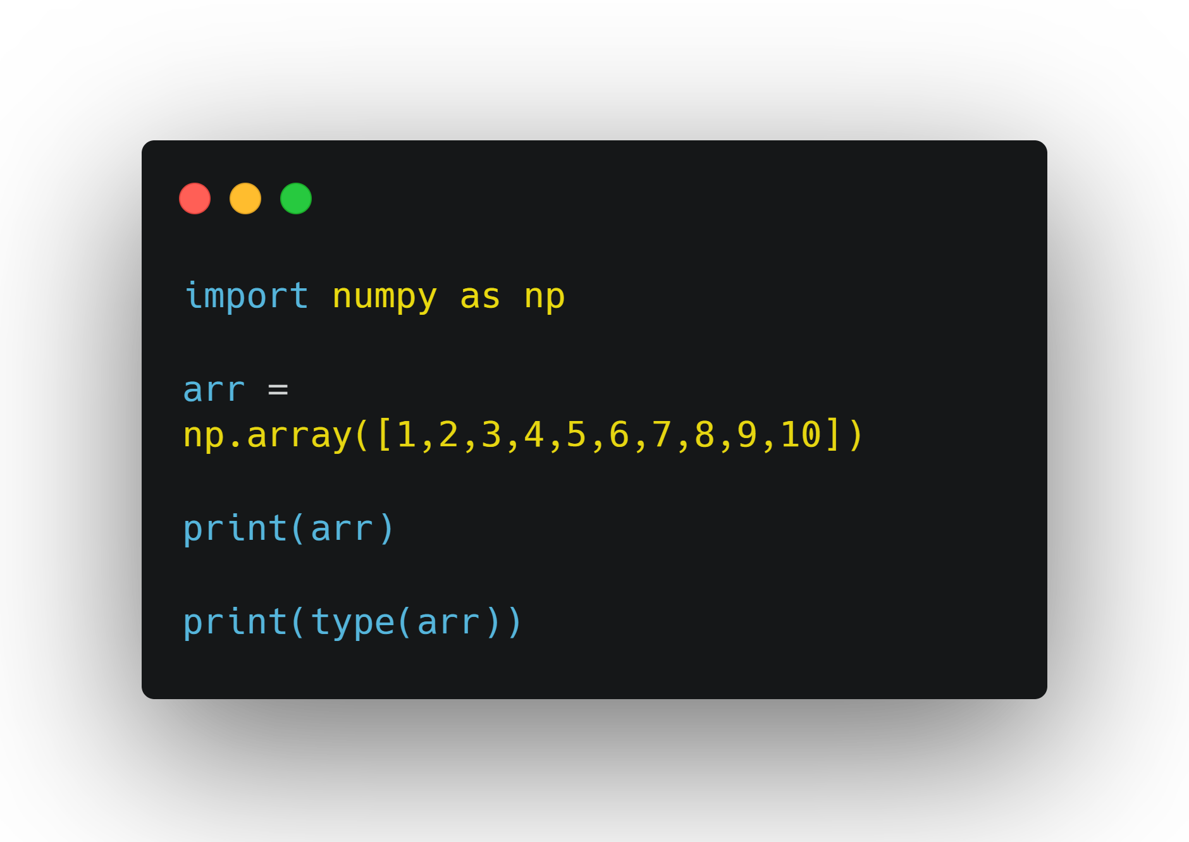
Creating Arrays
NumPy allows you to work with arrays very efficiently.
array() function

Slide 7
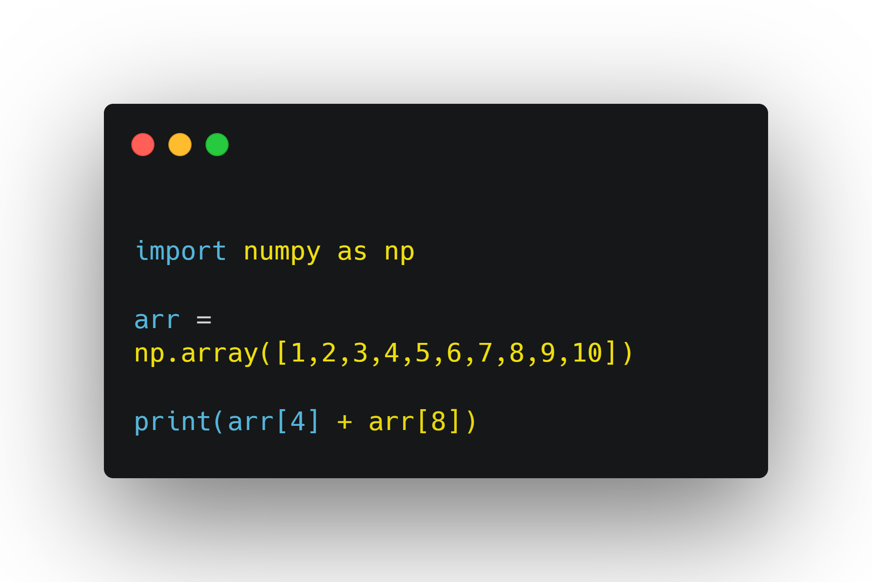
Indexing
Same thing as accessing an element of a list

Slide 8
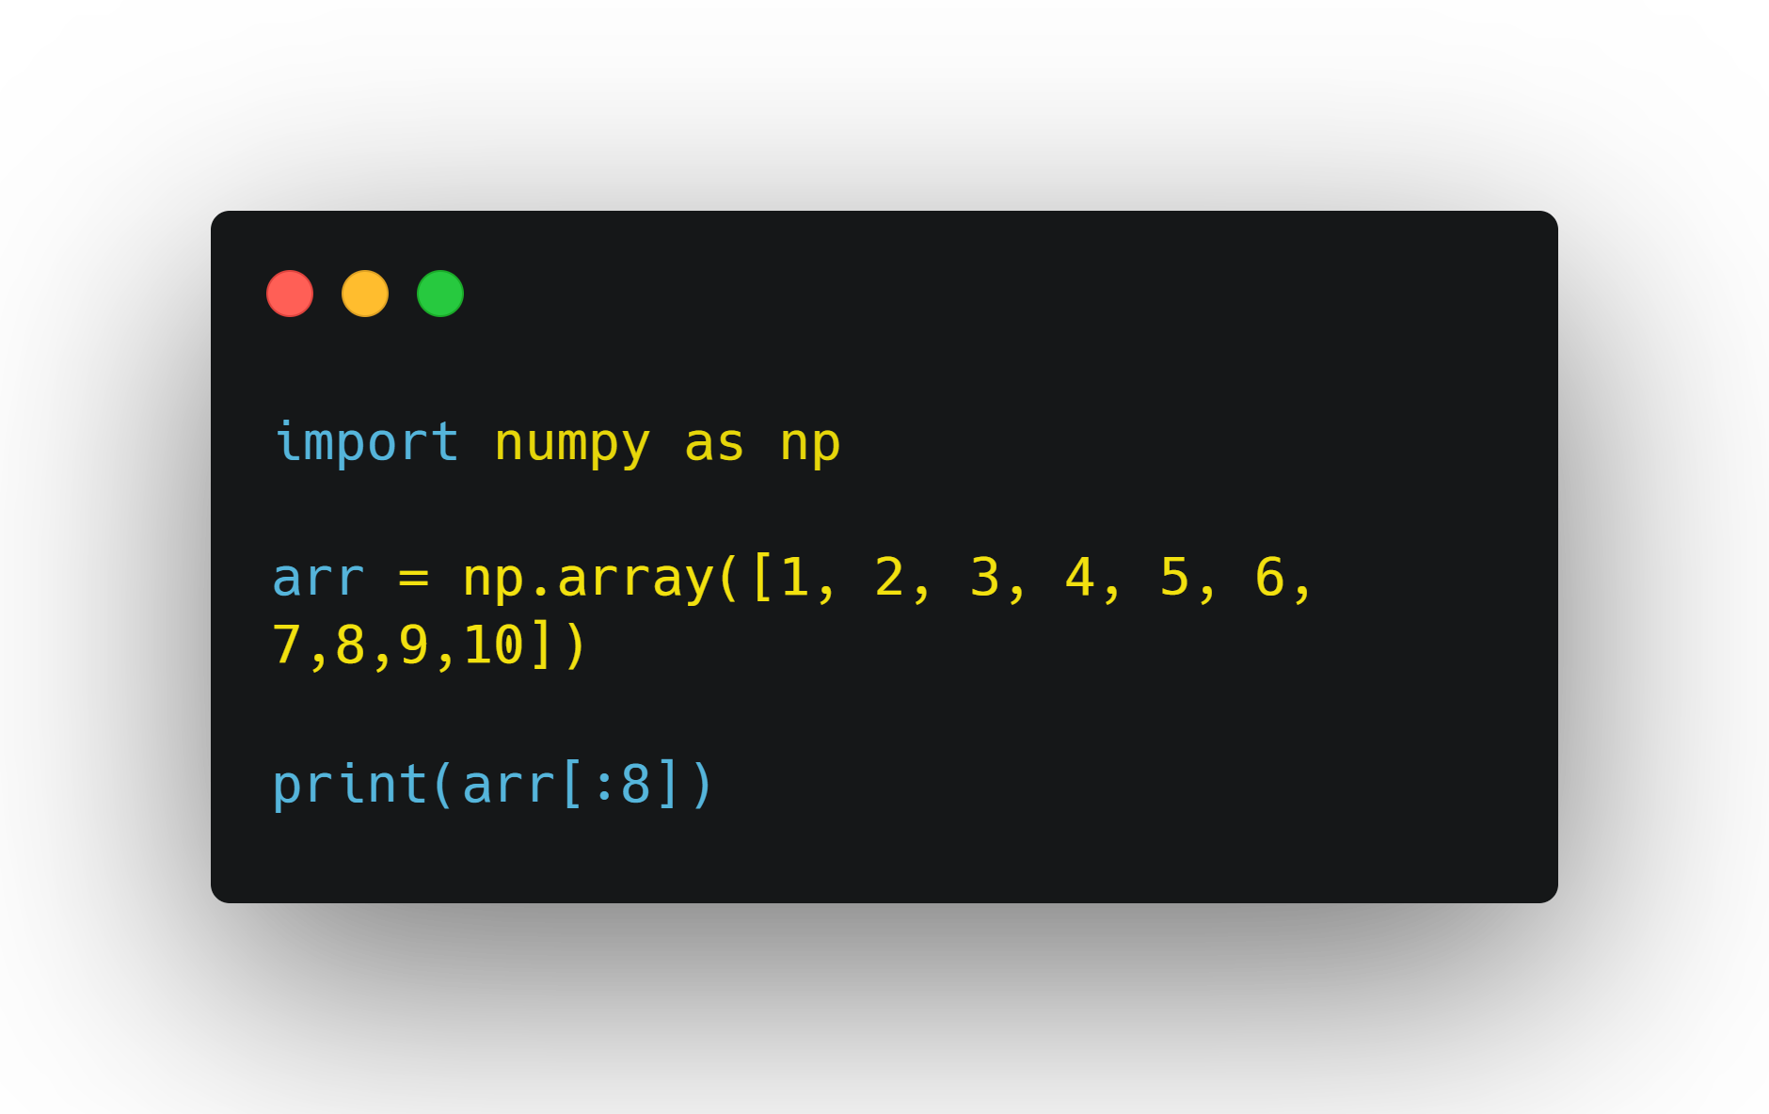
Slicing
Taking a part or subsection of an object
[start:end:step].

Slide 9
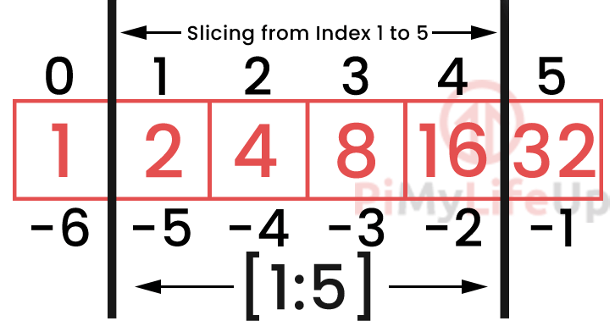
Slicing (continued)
No beginning index passed: assumed to start from beginning of the list.
No end index passed: assumed that we slice to the end.
No step index passed: assumed that we slice one at a time.
Negative step = backward slicing

Slide 10
1.0 Now Try this:
Create an array of at least size 10 and populate it with random numbers. Then, use slicing to split it into two and create two new arrays. Then, find the sum of the third digits in each array.

Slide 11
Data Types
i - integer S - String
b - boolean U - Unicode
f - float u - unsigned integer
c - complex float M - datetime
m - timedelta m - timedelta
O - object
V - fixed chunk of memory for other type ( void )

Slide 12
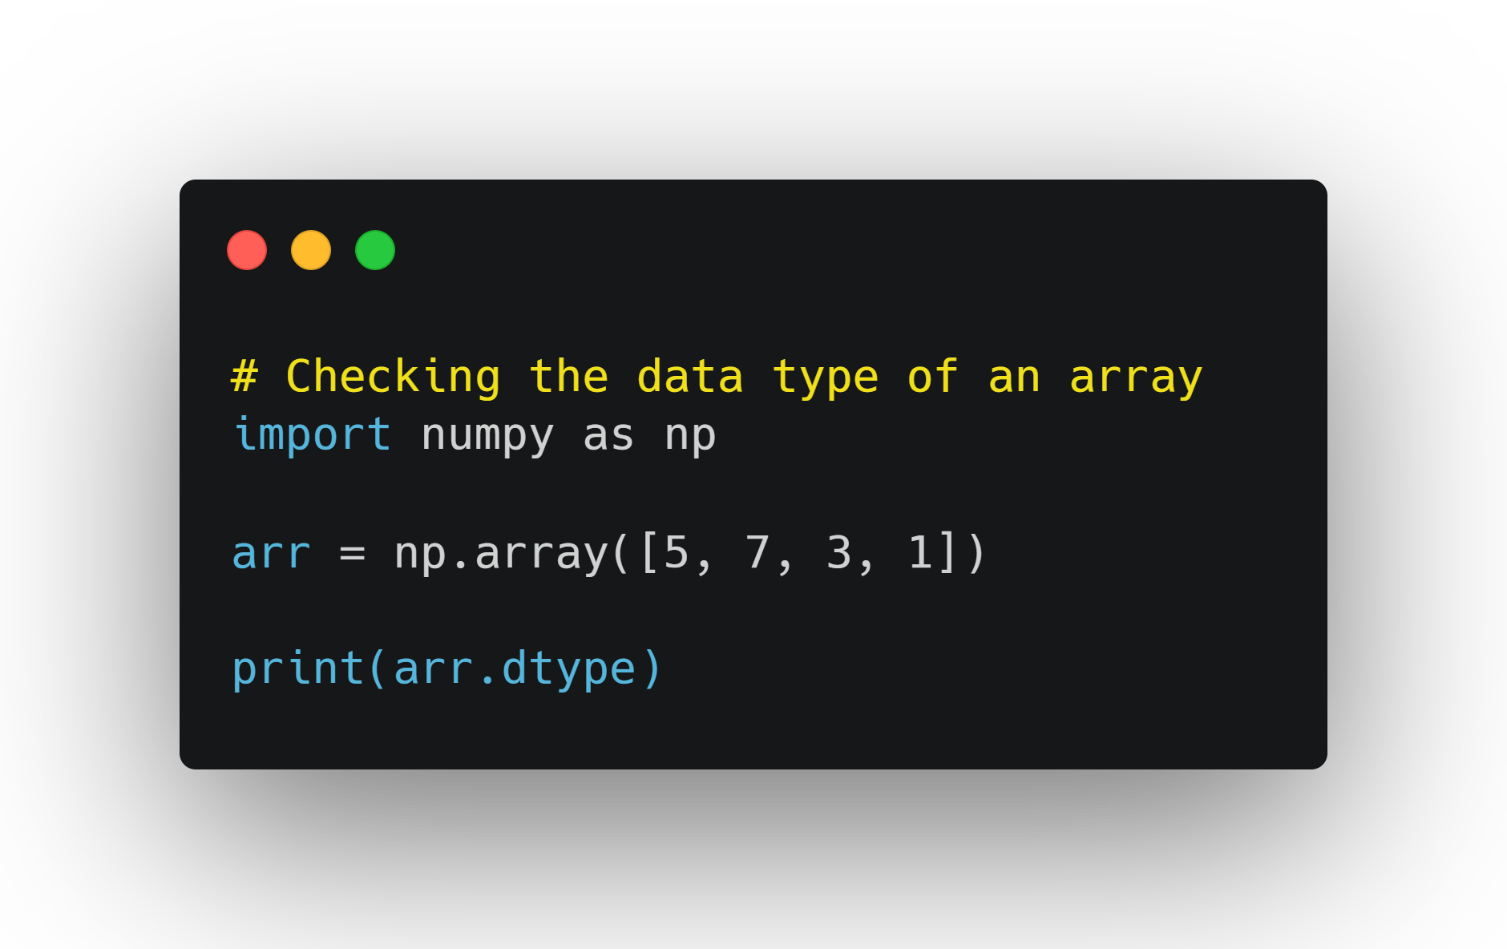
Data Types (continued)
Check the data type of an array:

Slide 13
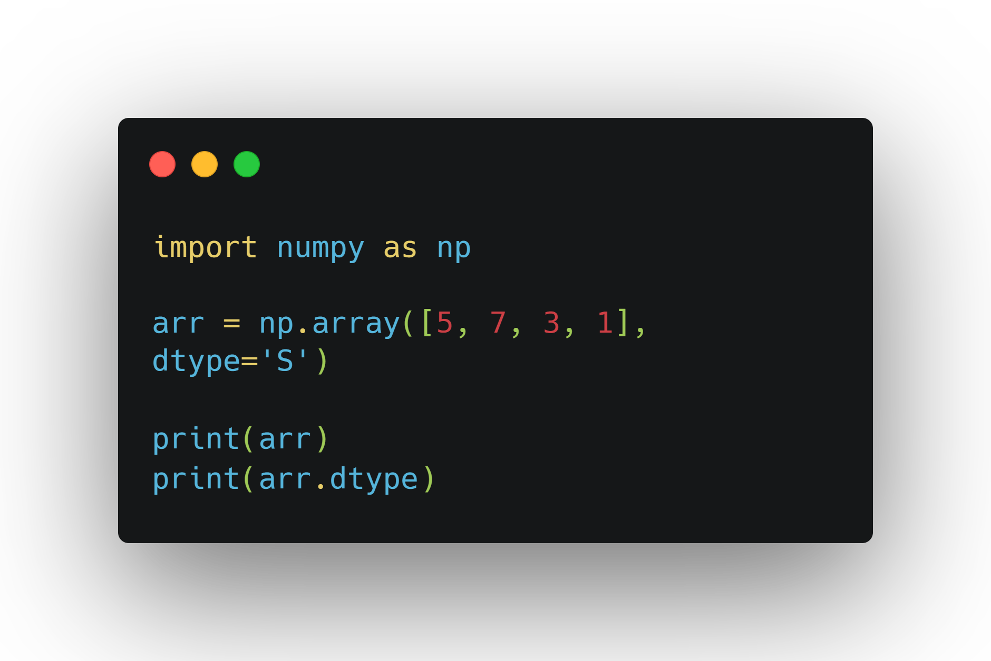
Data Types (continued)
Create an array with a defined type:

Slide 14
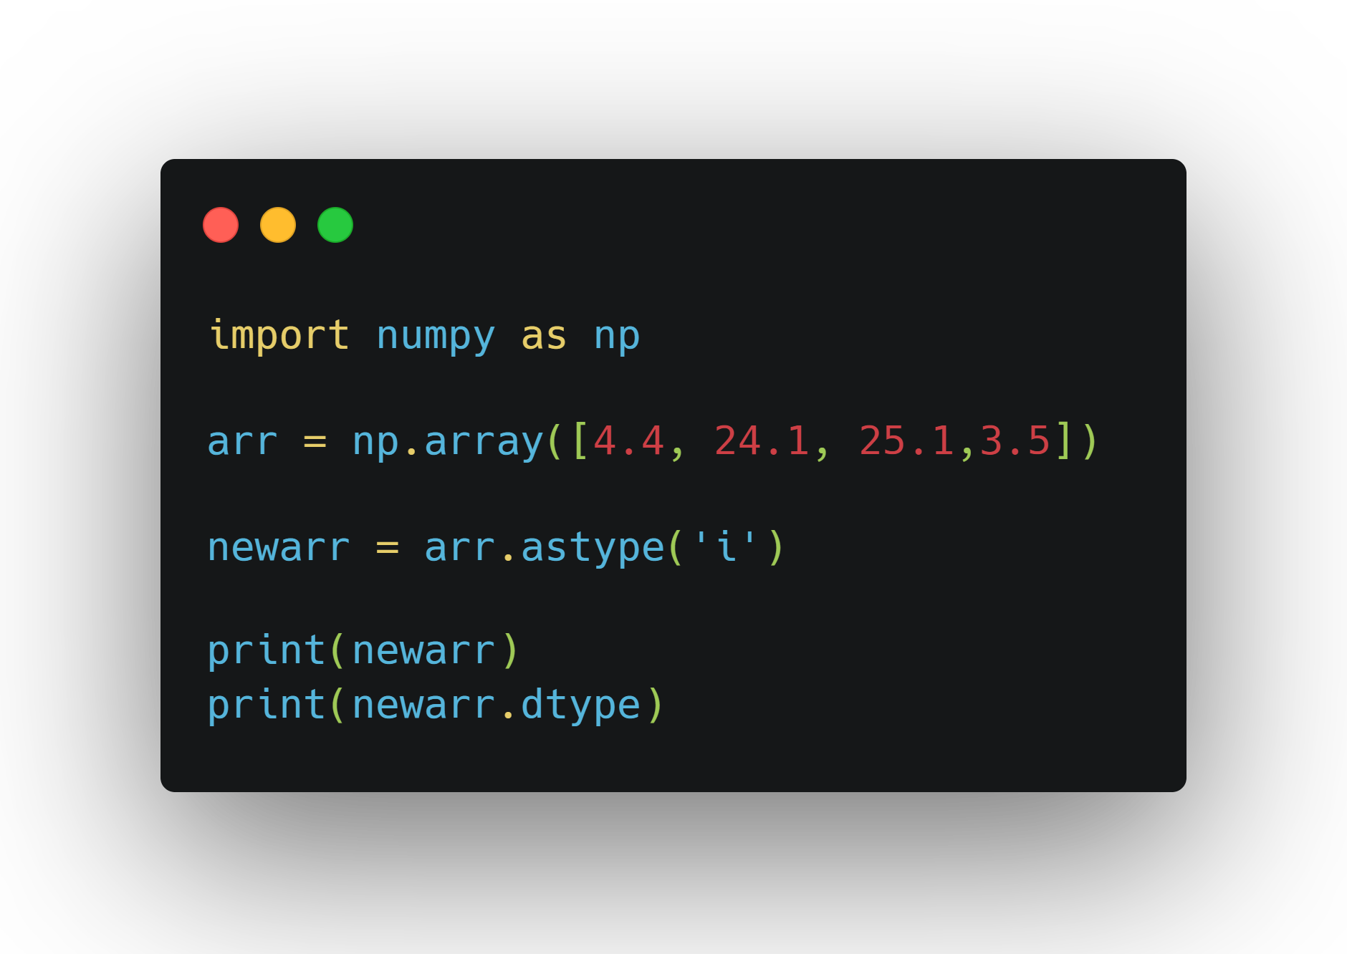
Data Types (continued)
Convert between types

Slide 15
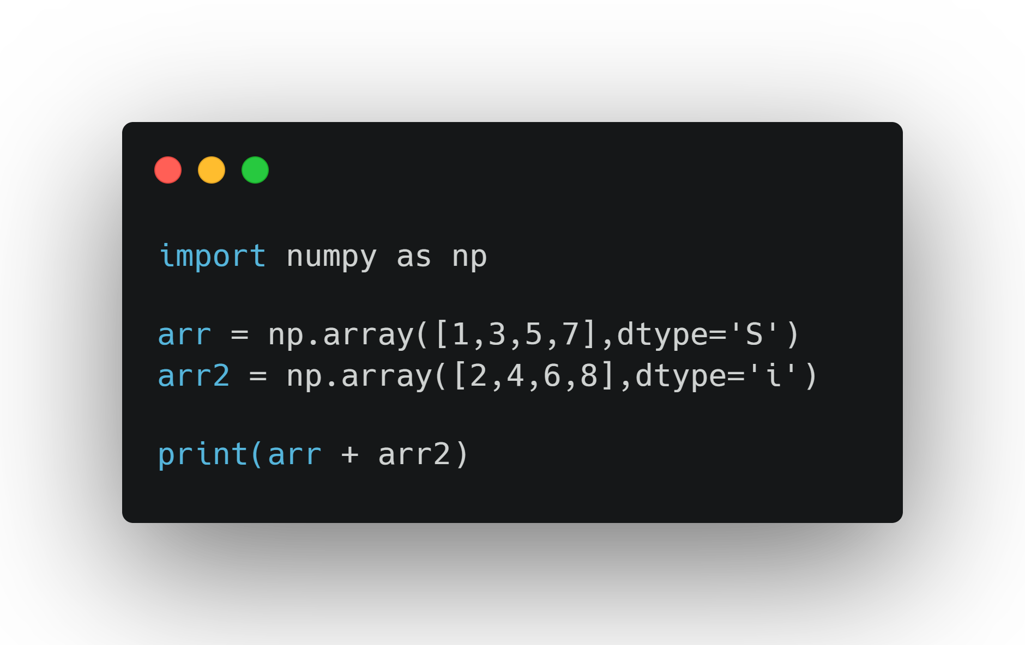
Now Try this
Modify the code below to fix the error and make the addition work

Slide 16
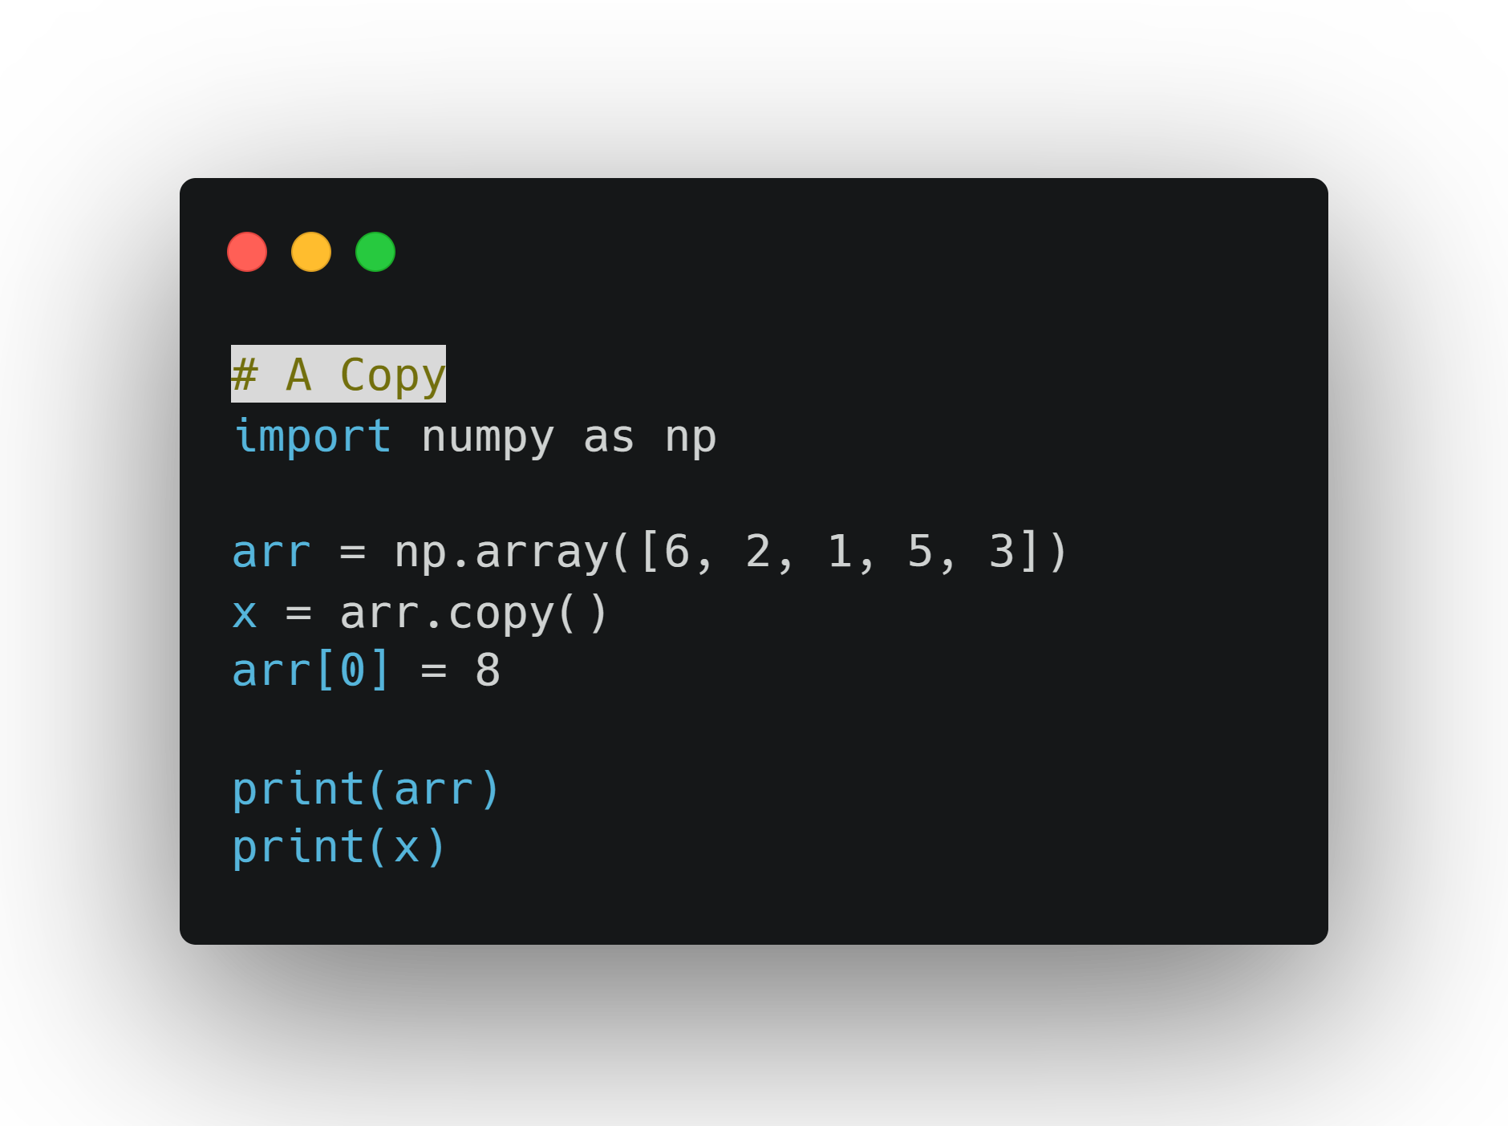
Copy vs View
you can work with either a copy of the data or the data itself.

Slide 17
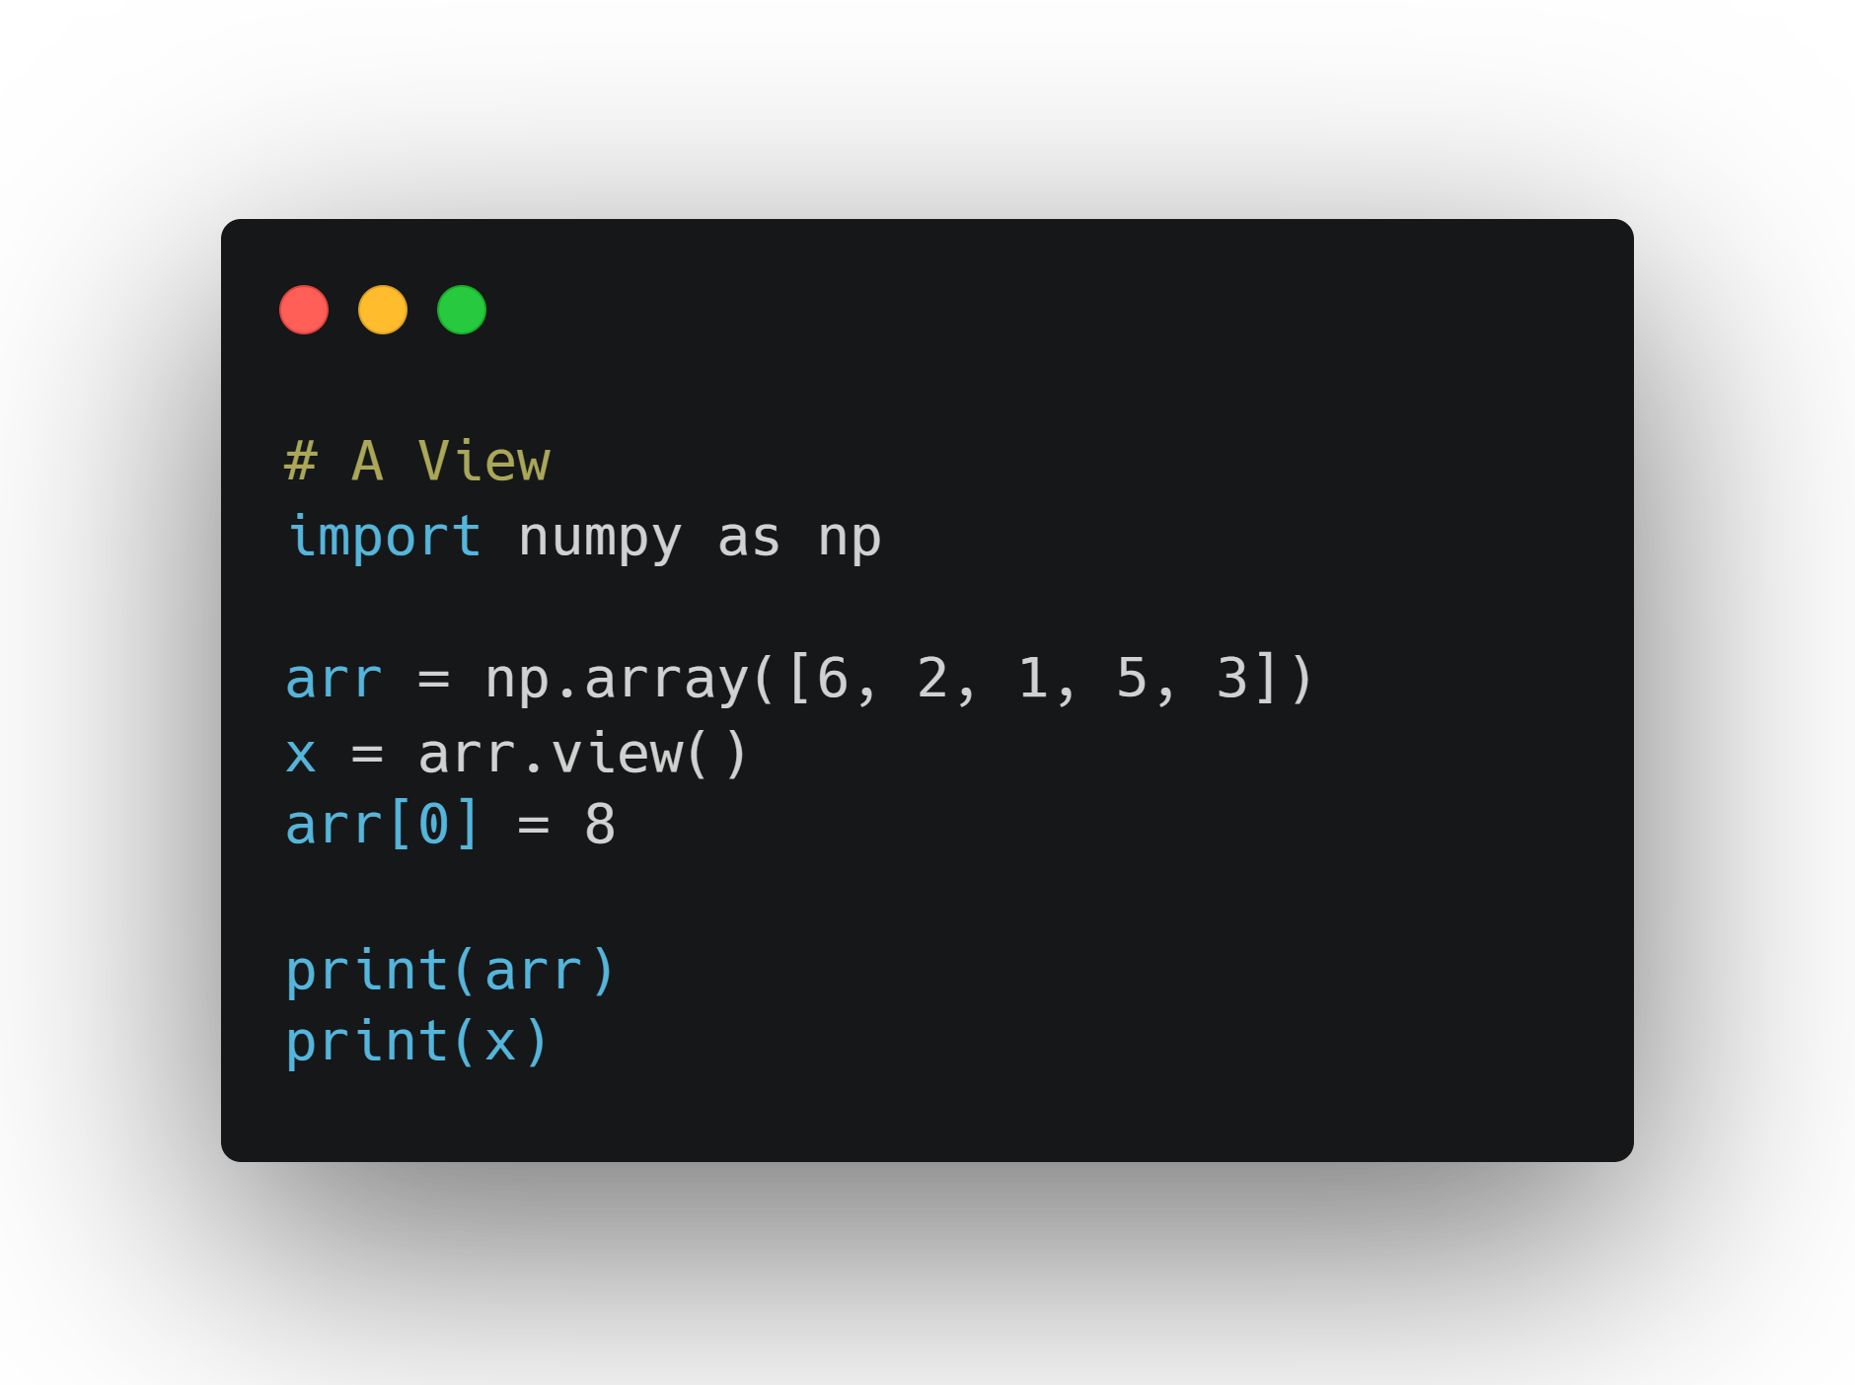
View

Slide 18
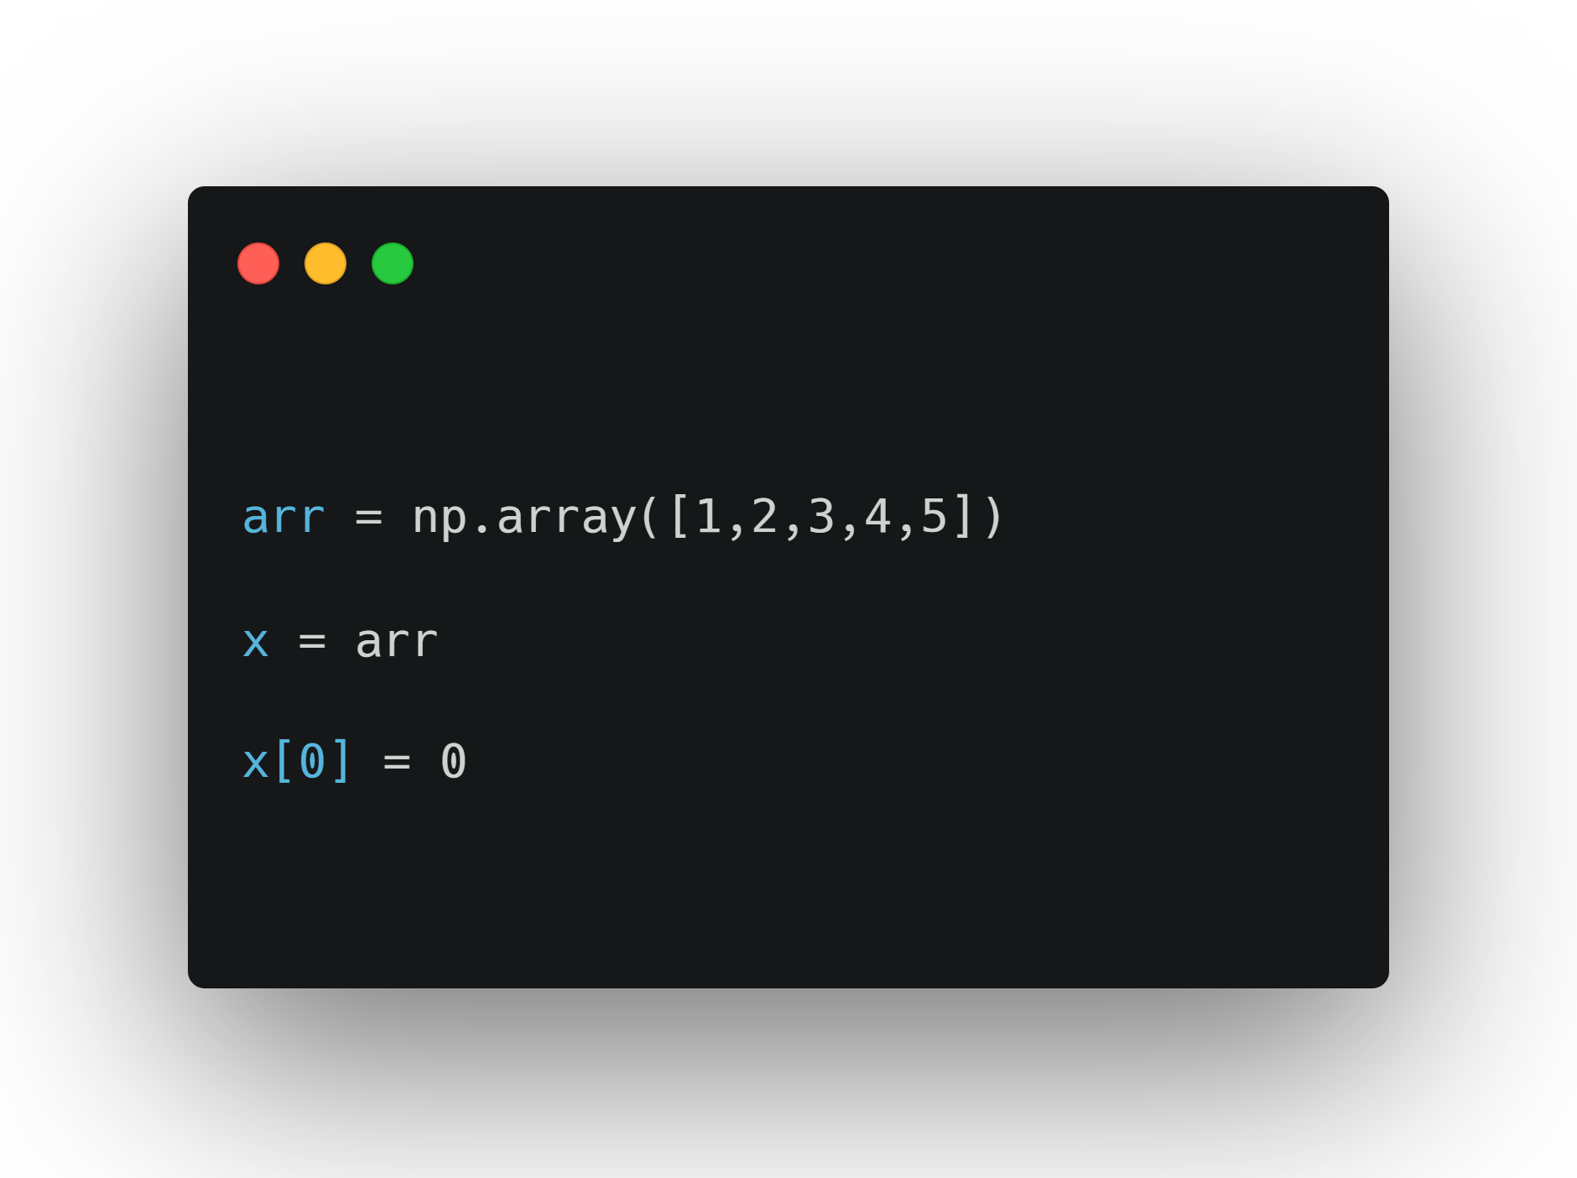
3.0 Now Try This
A student wants to create a copy of an array and modify the first element. The following is the code they wrote for it. Is this correct?

Slide 19
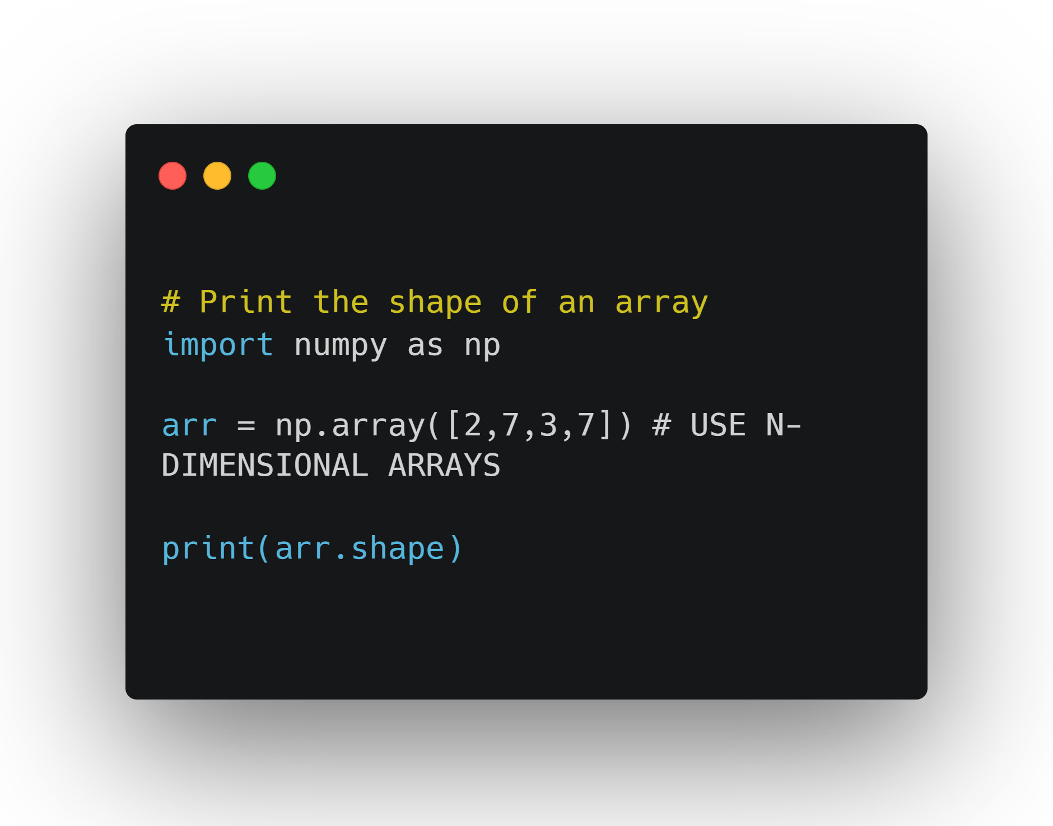
Shape
All NumPy arrays have an attribute called Shape.
Helpful for 2d (or nd) arrays

Slide 20
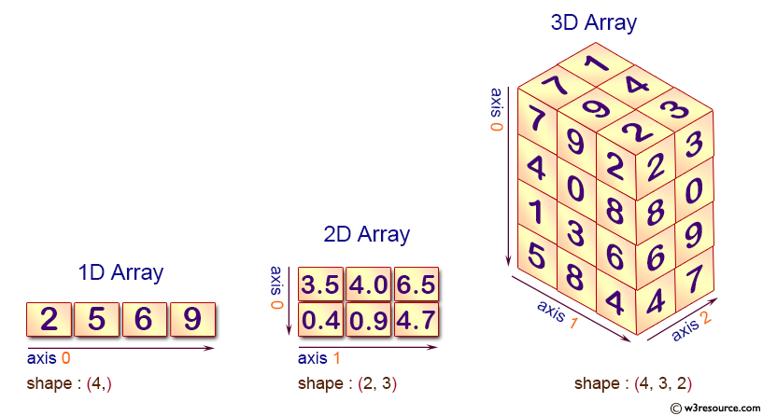

Slide 21
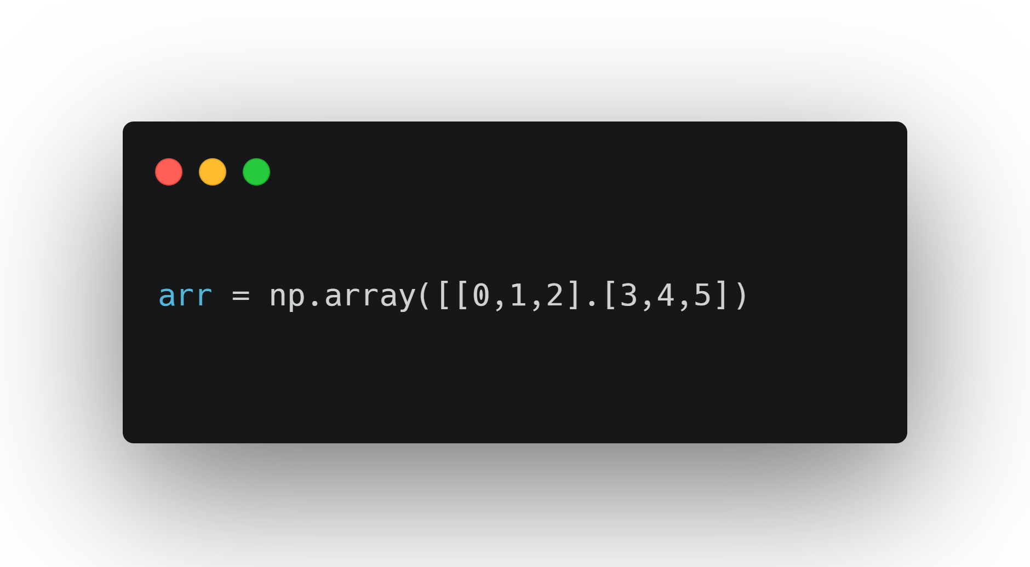
4.0 Now Try This:
Without using Python, what is the shape of this array? Answer in the same format as the shape method.

Slide 22
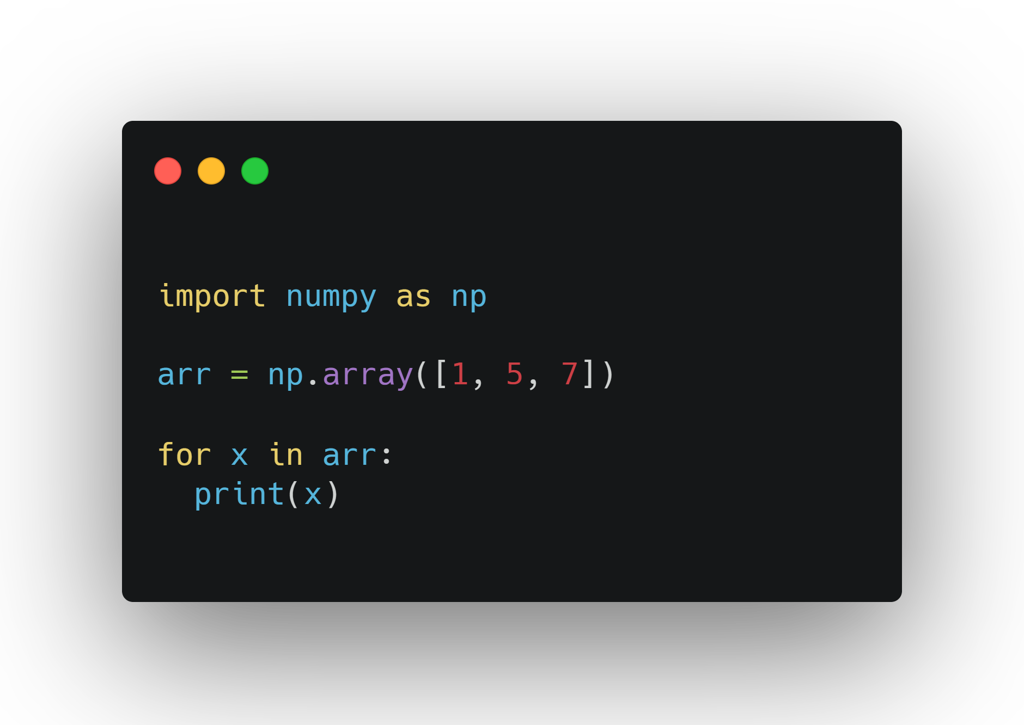
Iterating through arrays
Iterate through each item in an array using a loop

Slide 23
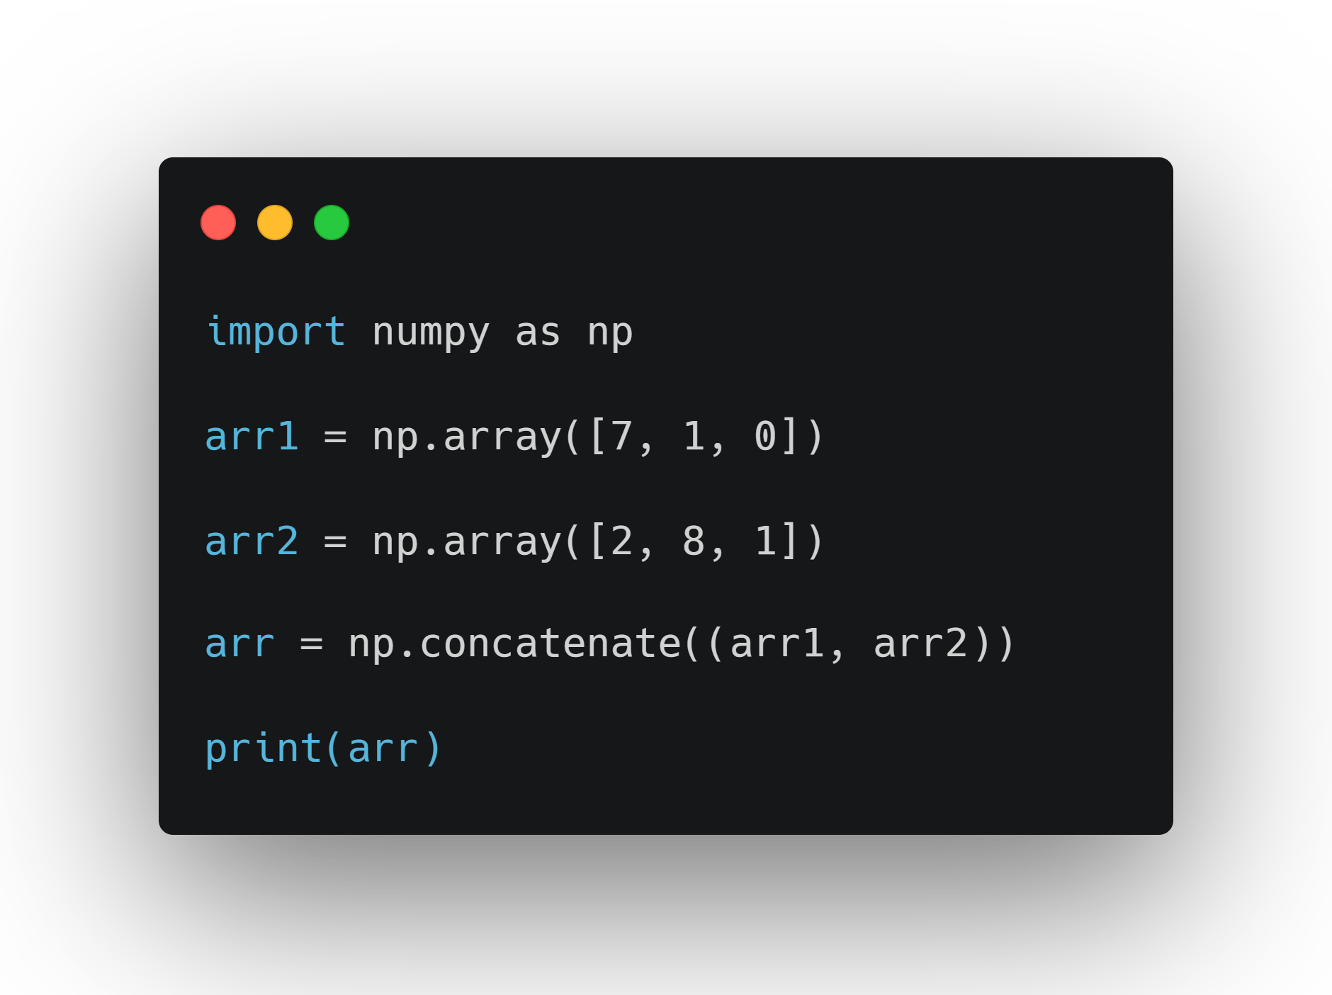
Joining arrays
Combining elements of multiple arrays into one.

Slide 24
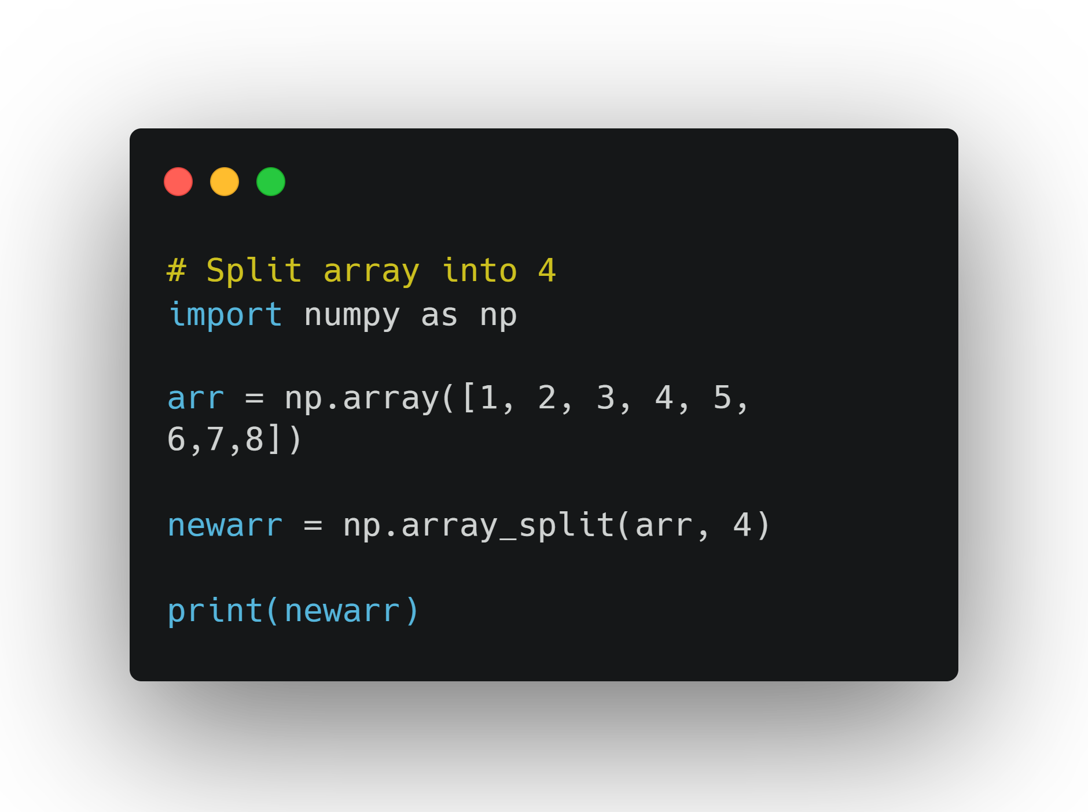
Splitting arrays
Opposite of joining arrays
Take one array and make multiple arrays from it

Slide 25
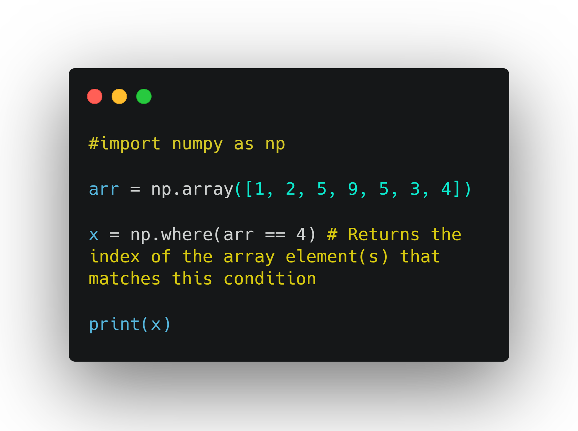
Searching Arrays
Finding a certain element in an array. Use where()

Slide 26
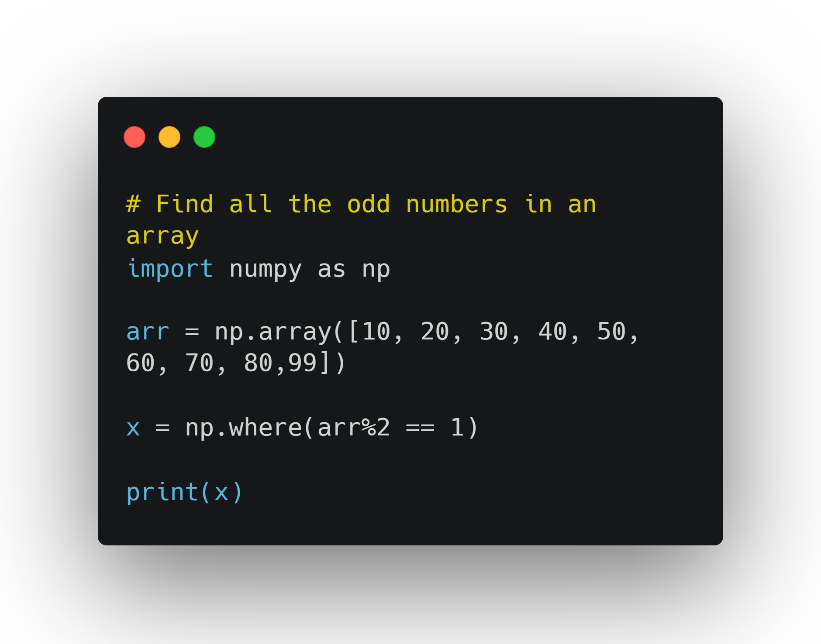

Slide 27
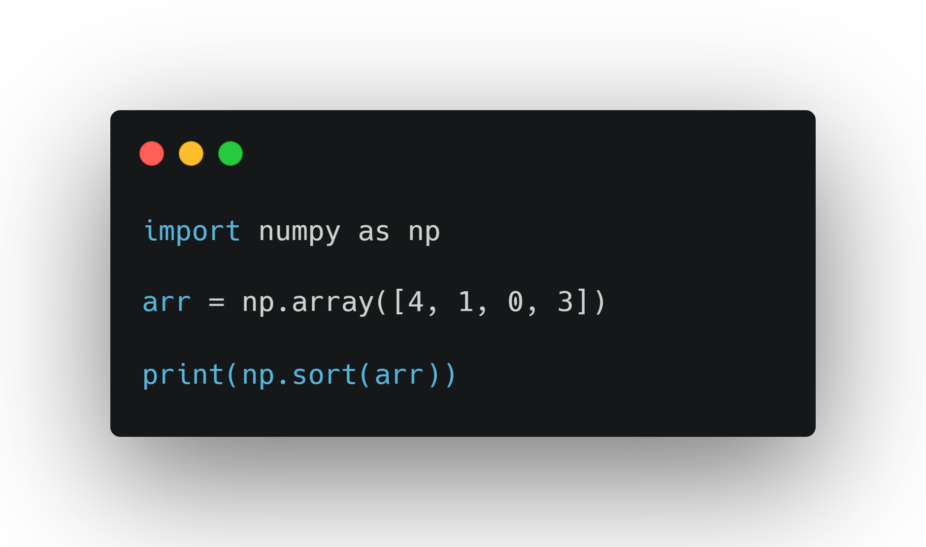
Sorting Arrays

Slide 28
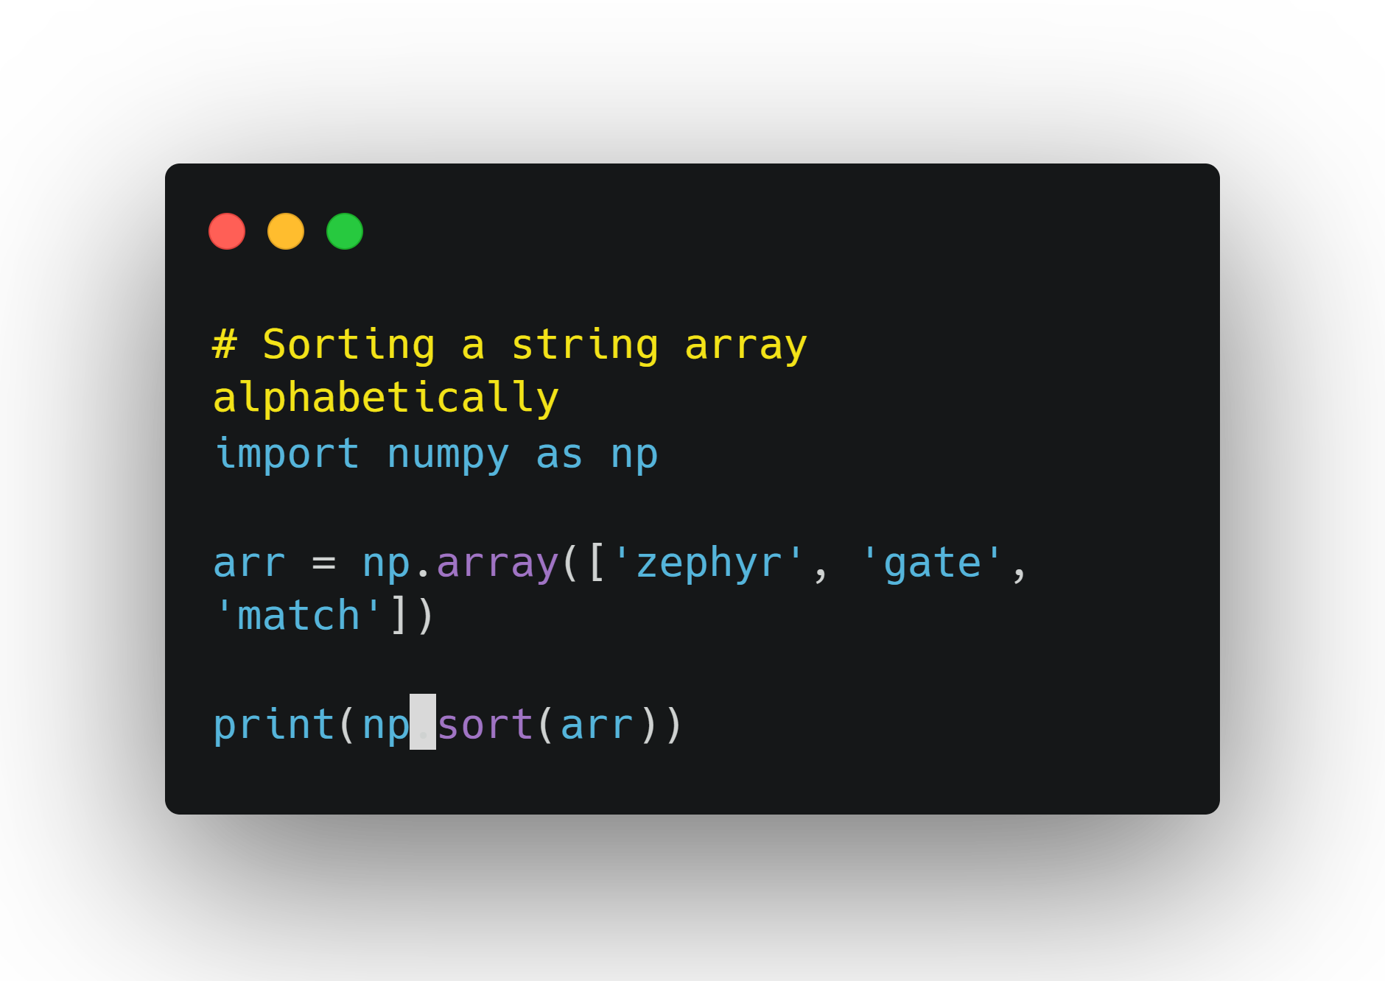

Slide 29
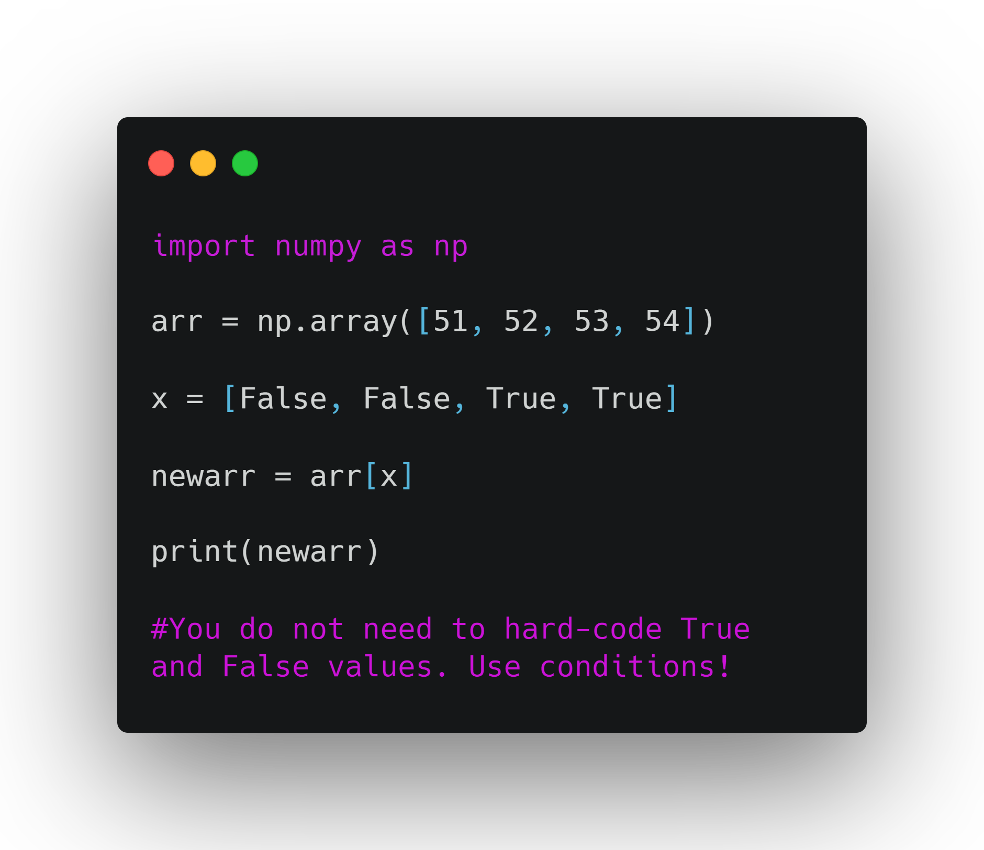
Filtering Arrays
Create a new array that includes elements from an initial array based on a condition.
Numpy uses Boolean Index List to filter.

Slide 30
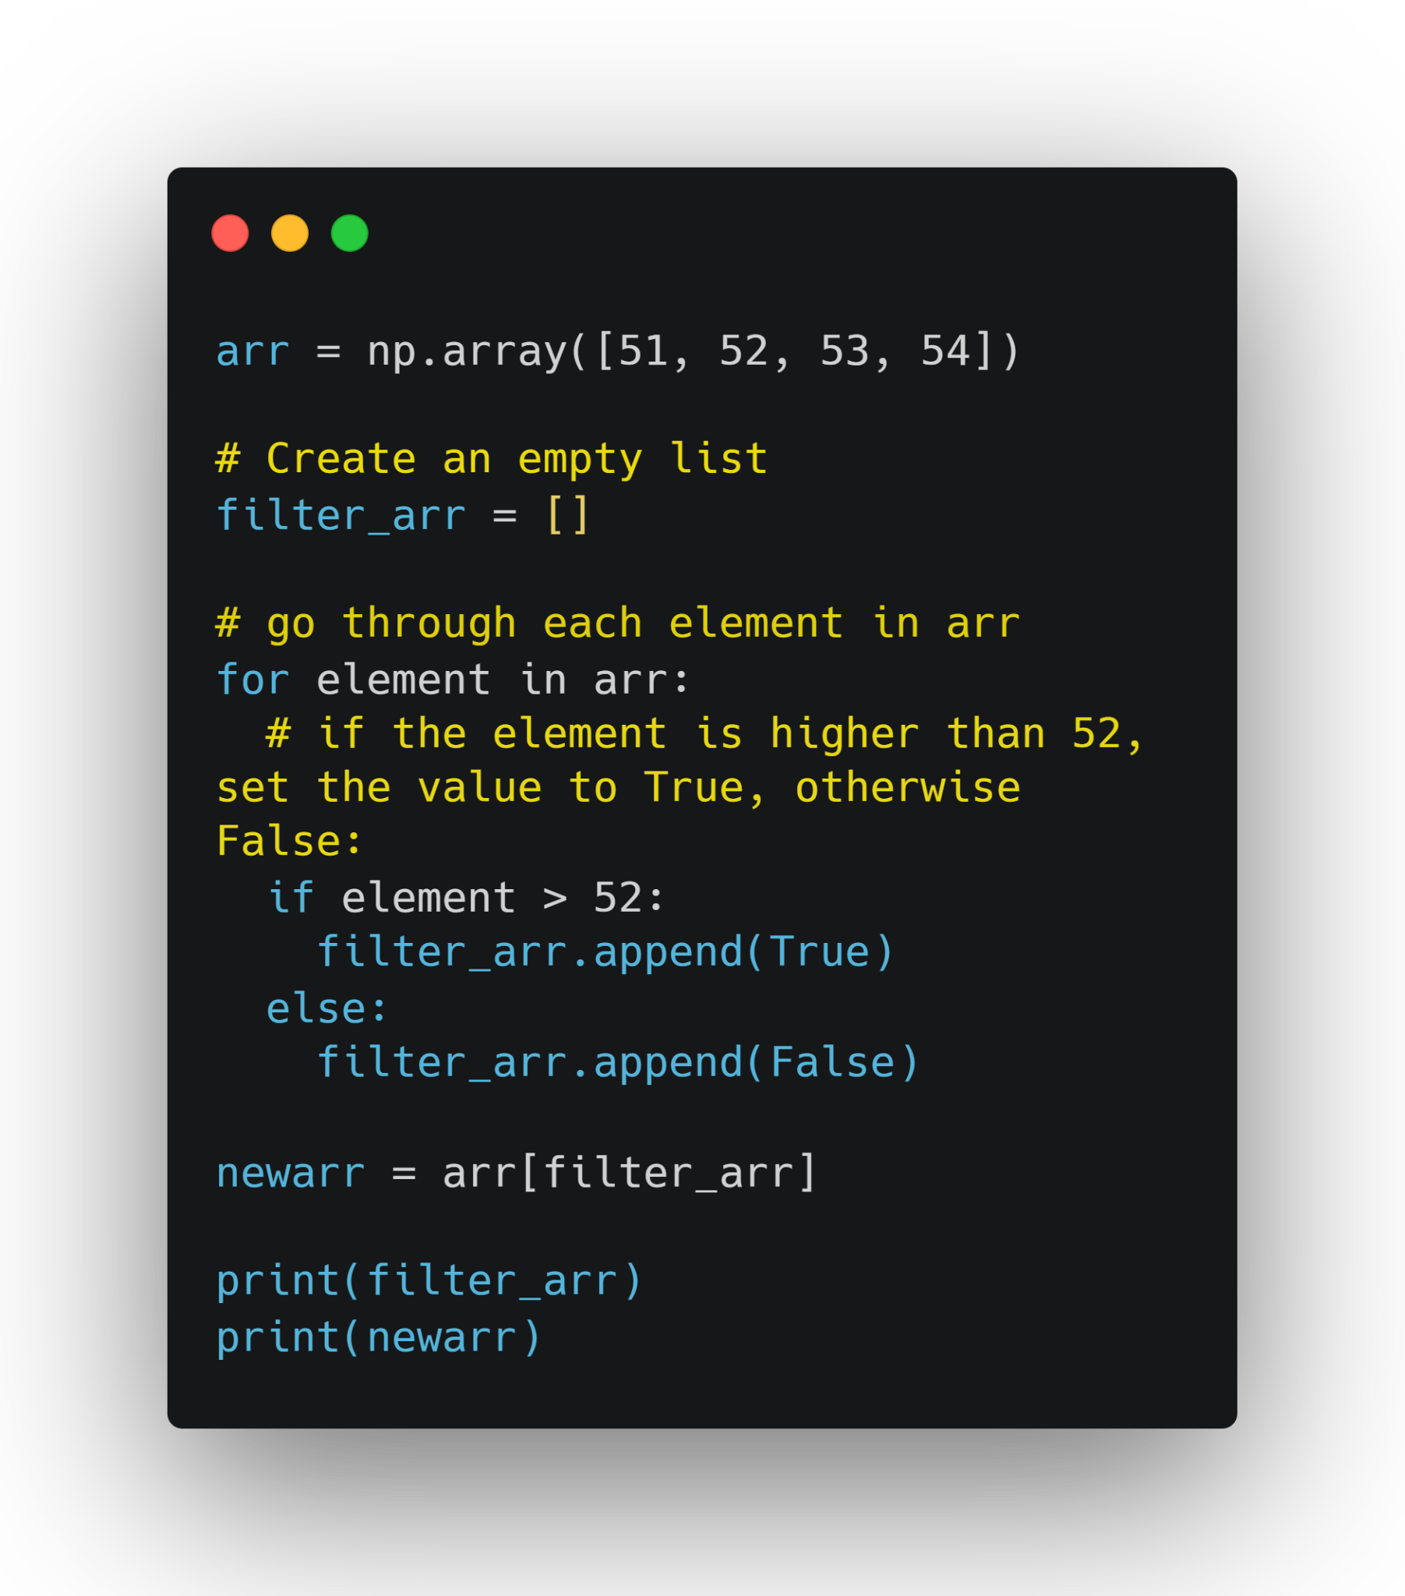

Slide 31
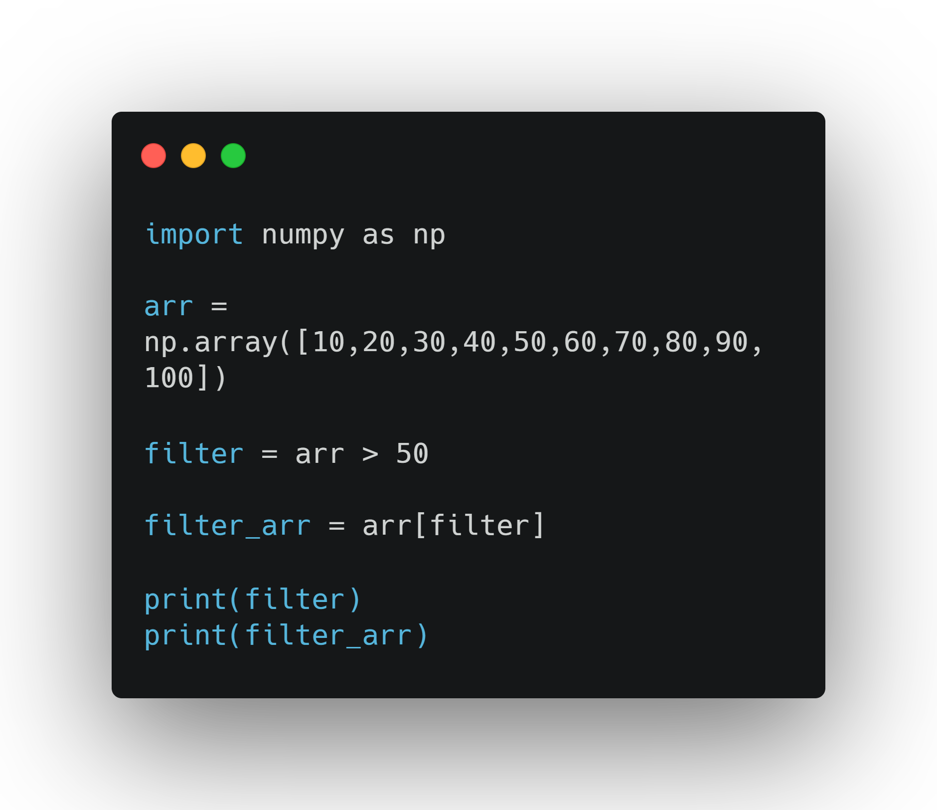
Create a boolean index list directly from the target array
Apply it to obtain the filtered array

Slide 32
5.0 Now Try This:
Create an array with the first 10 numbers of the Fibonacci sequence. Split this array into two. On each half, search for any multiples of 4. Next, filter both arrays for multiples of 5. Finally, take the two filtered arrays, join them, and sort them.

Slide 33
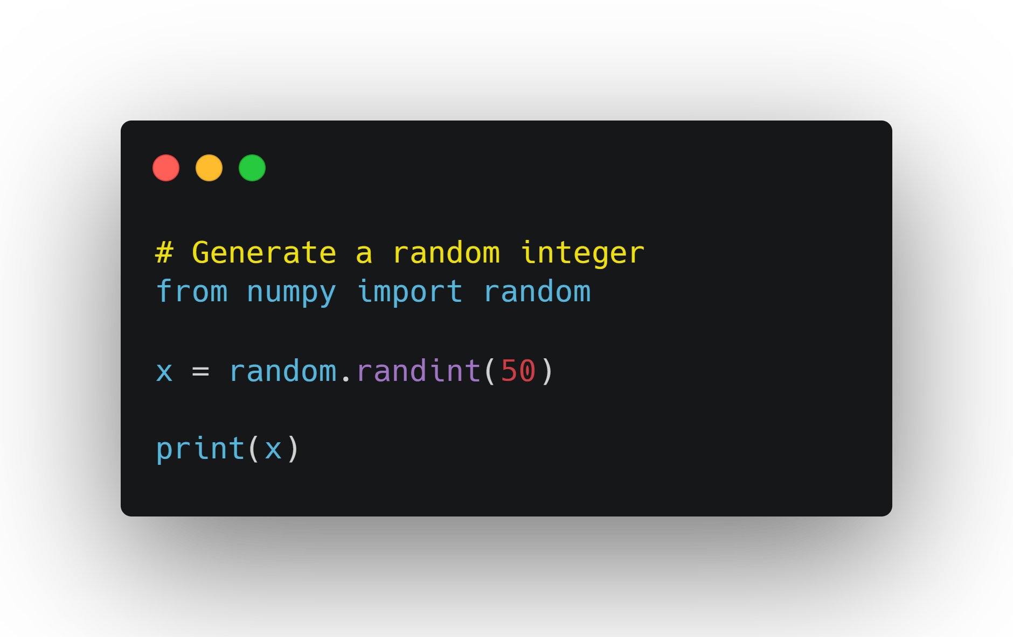
Random Numbers and distribution
Important in creating simulations

Slide 34
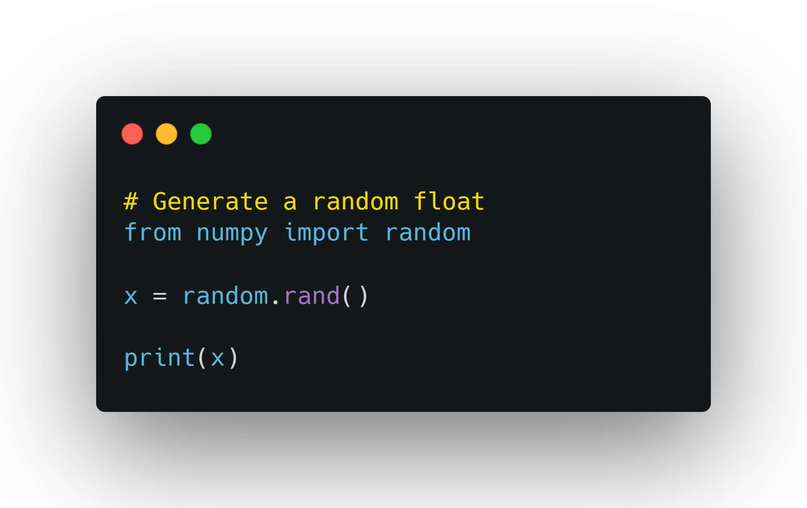

Slide 35
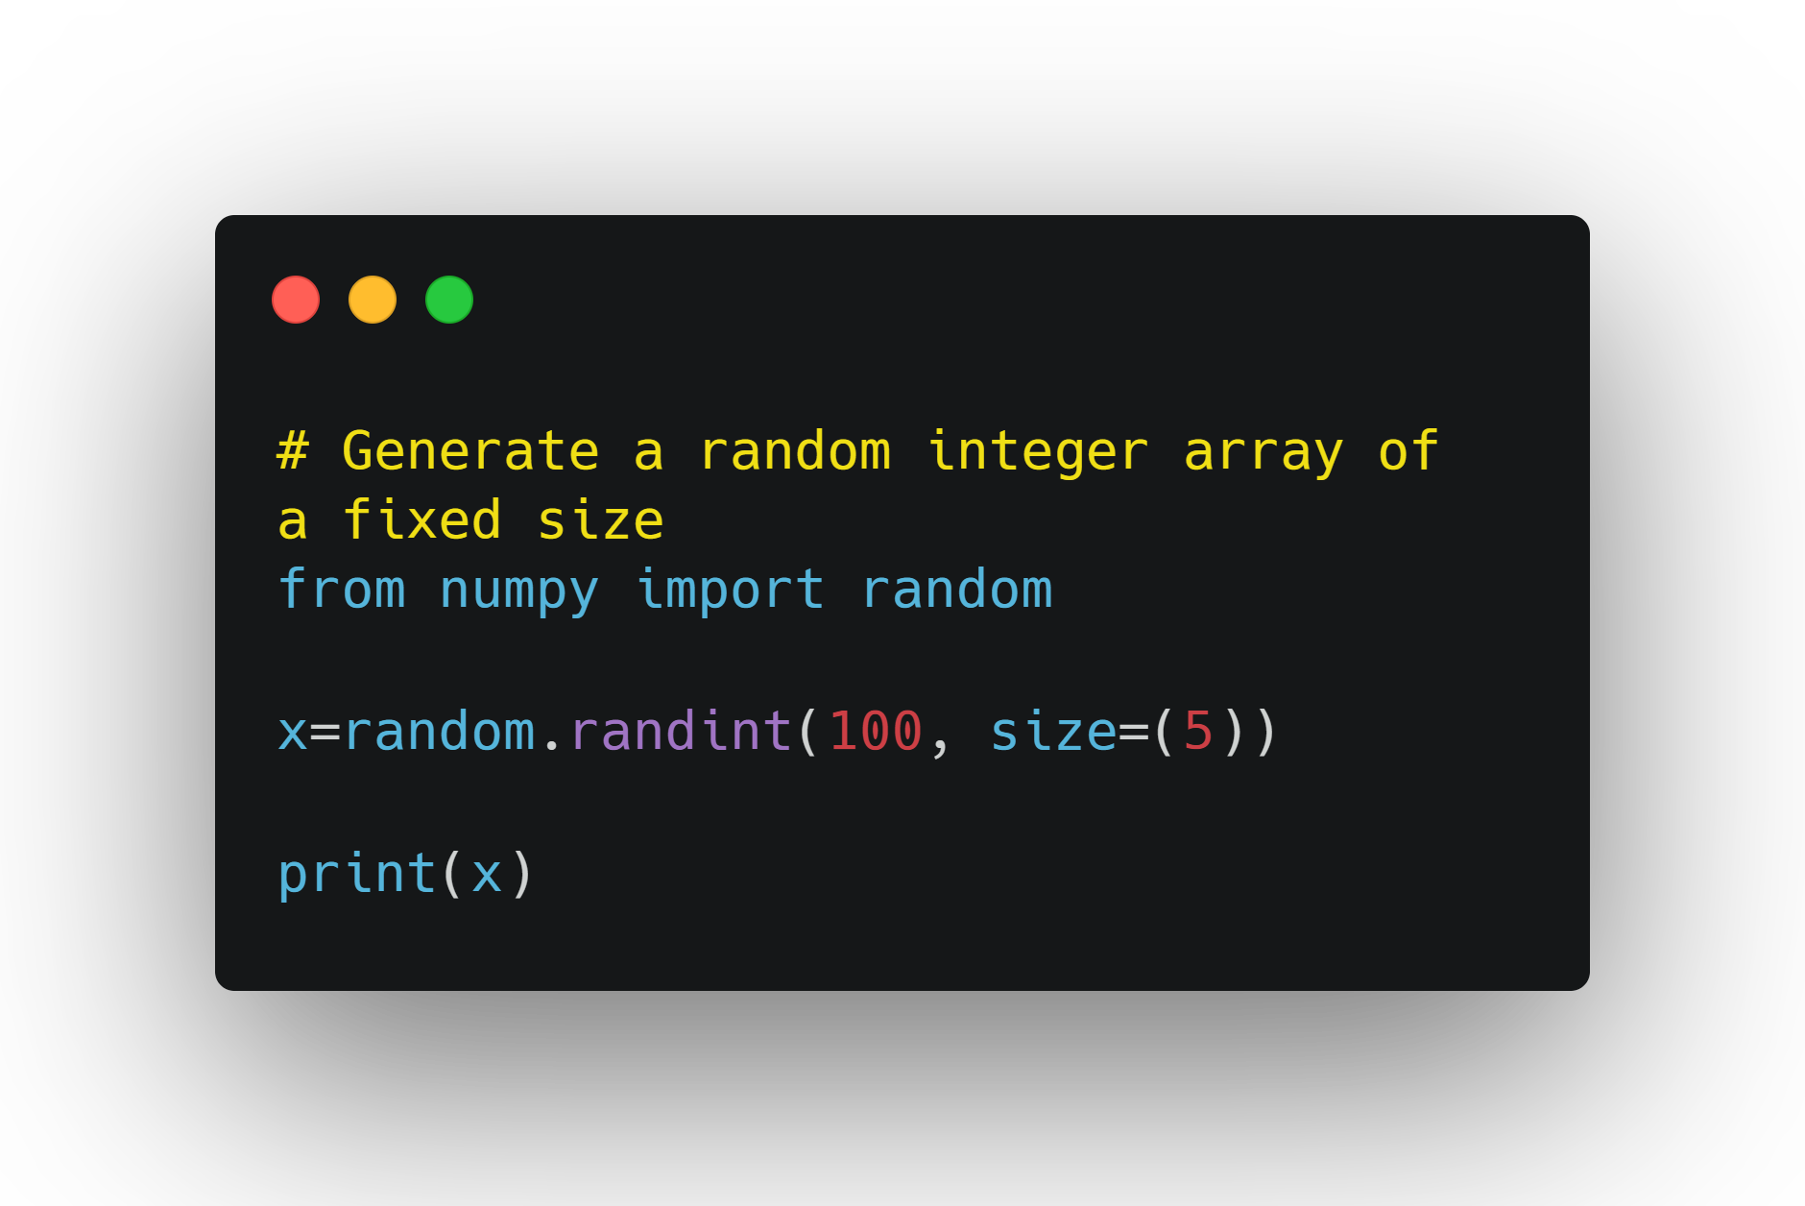

Slide 36
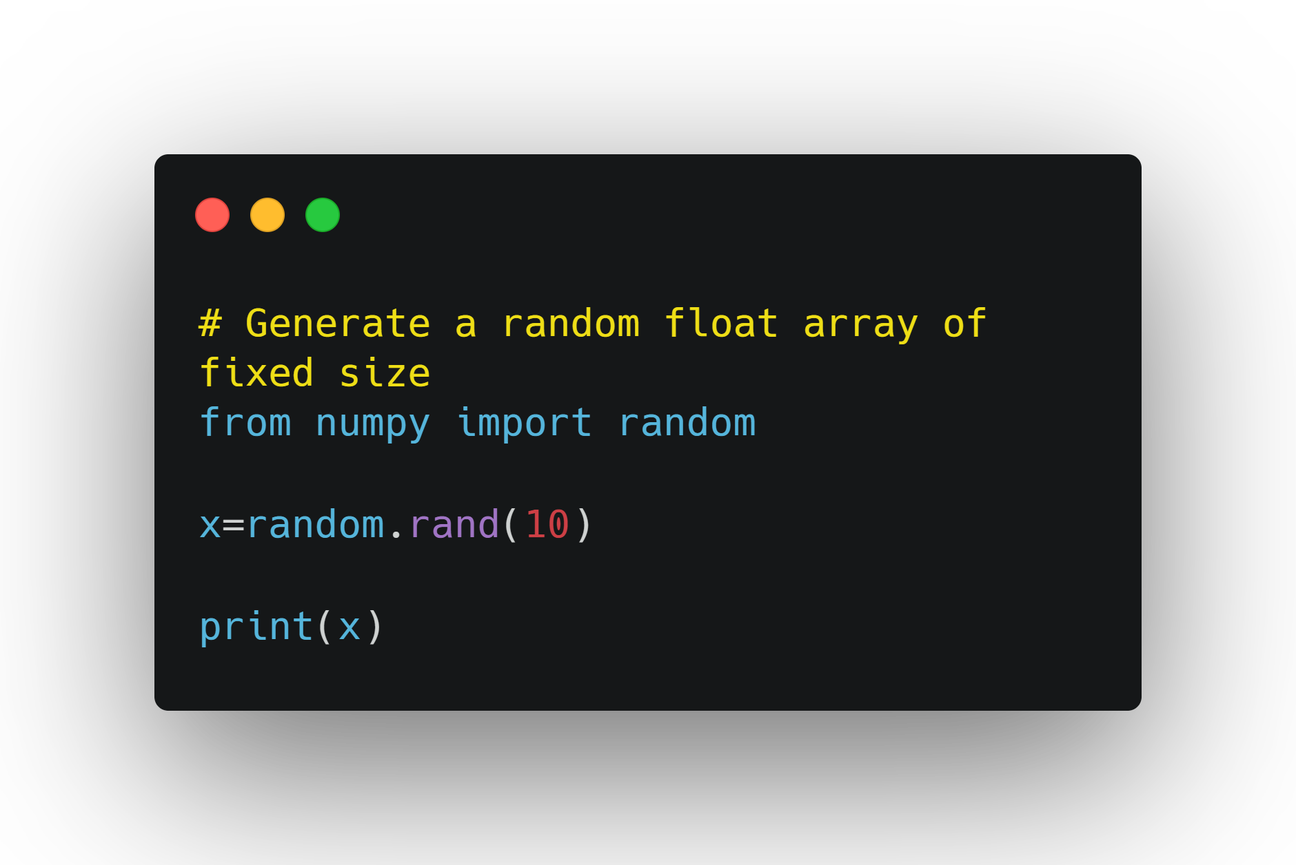

Slide 37
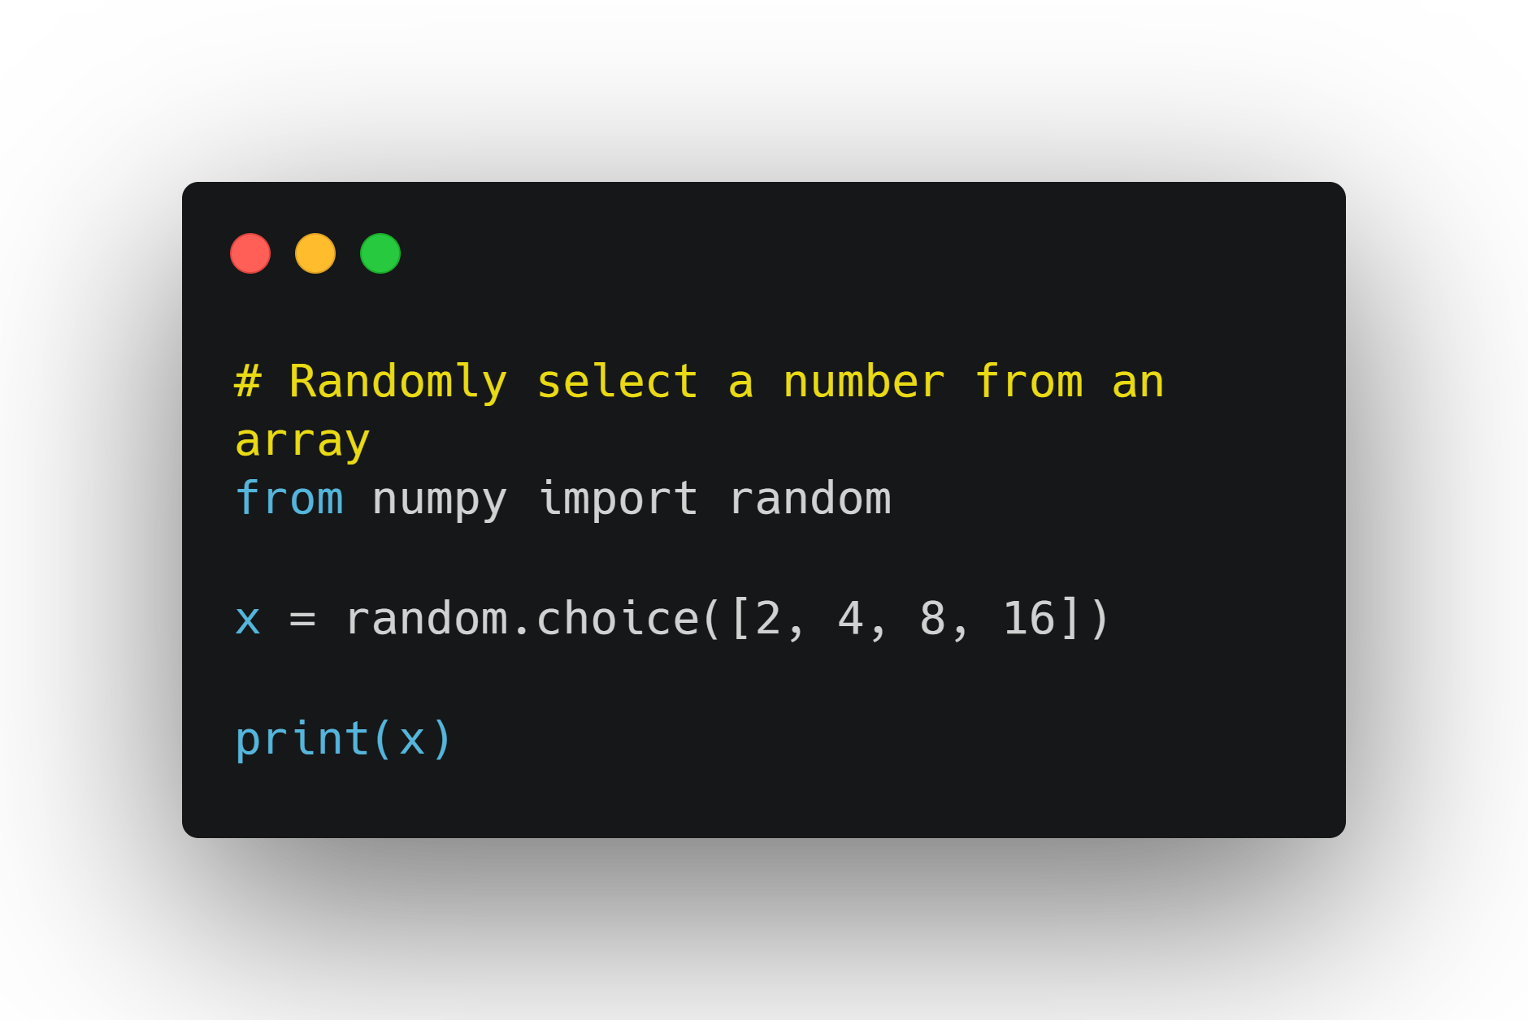

Slide 38
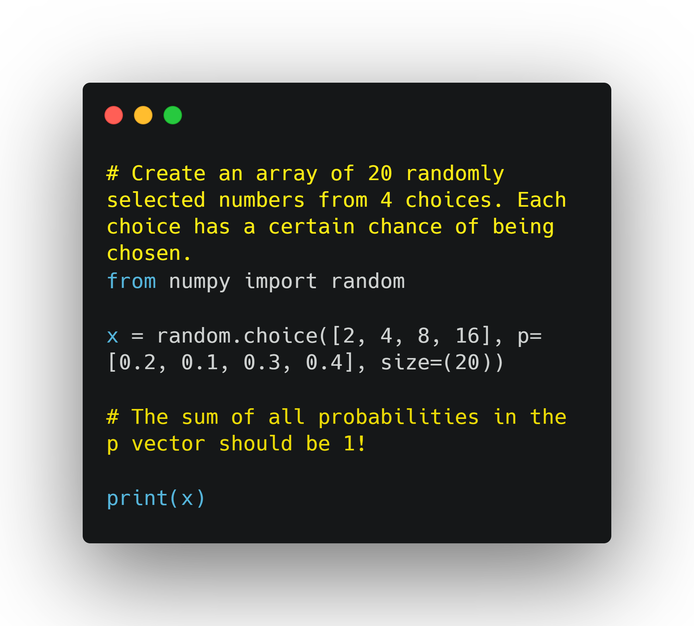
Random Distribution
Set of random numbers that each have a set probability of being selected

Slide 39
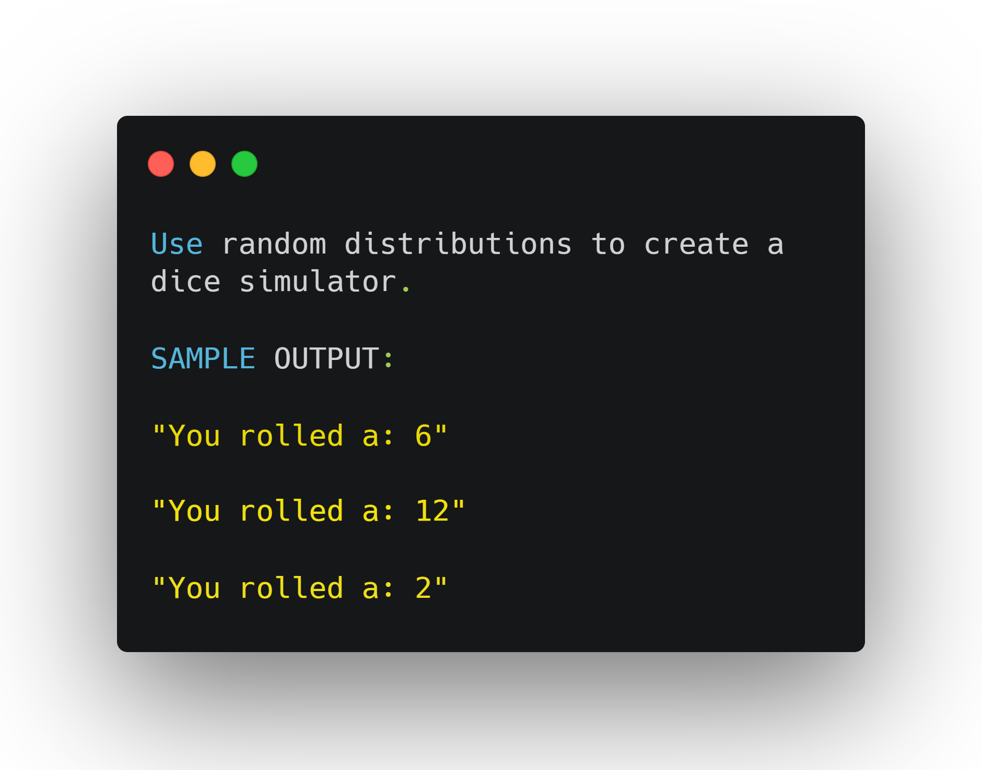
6.0 Now Try This

Slide 40
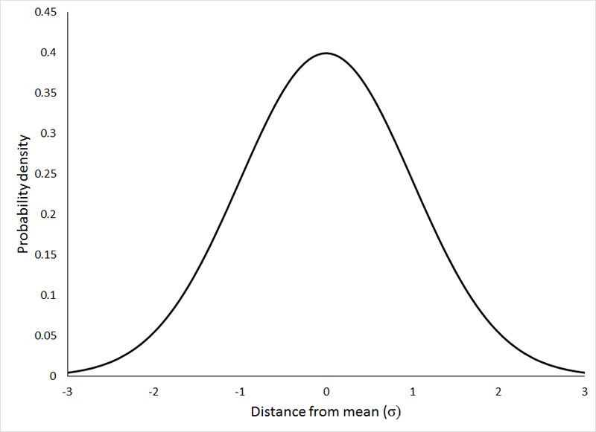
Normal Distribution

Slide 41
Normal Distribution
Is called "normal" because of how commonly it is found in nature.
In NumPy, you can utilize the normal distribution with the help of the random.normal() function
The function has 3 parameters to itloc - the mean of the distribution, scale - the standard deviation of the distribution, and size - the shape of the returned array.

Slide 42
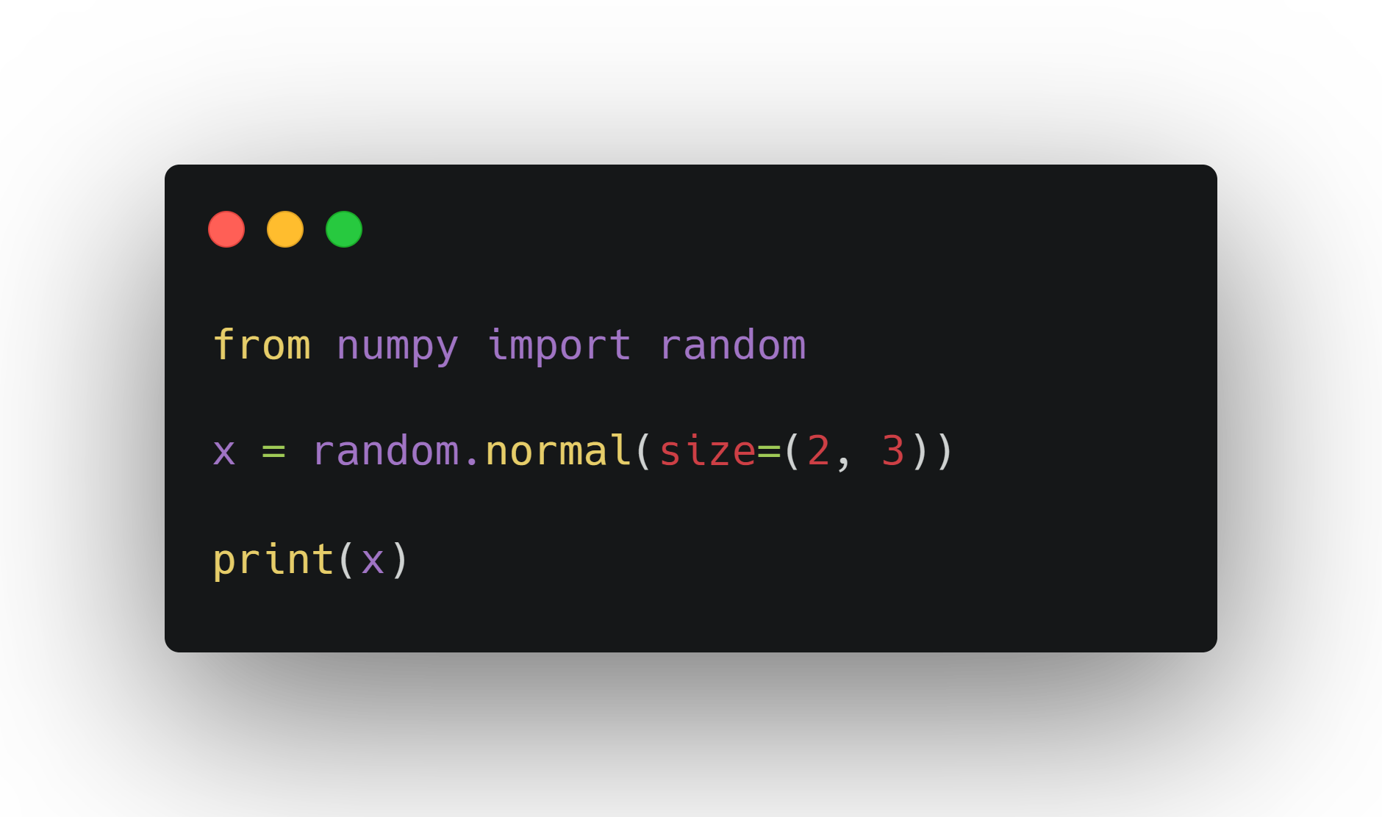
Add Bell Curve

Slide 43
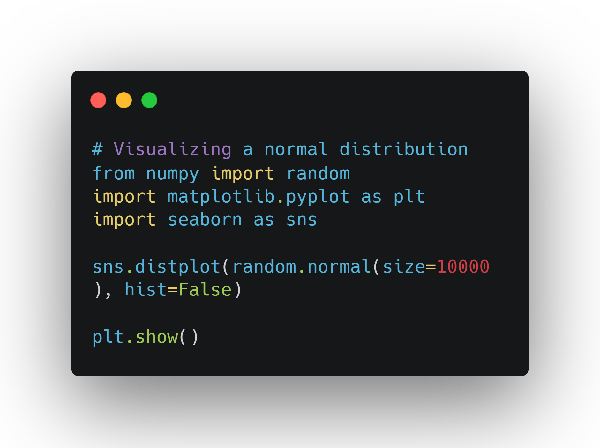

Slide 44
Universal Functions
Built-in NumPy methods that work on NumPy array objects, or ndarrays.
Iterate through a process called vectorization (faster than loops)

Slide 45
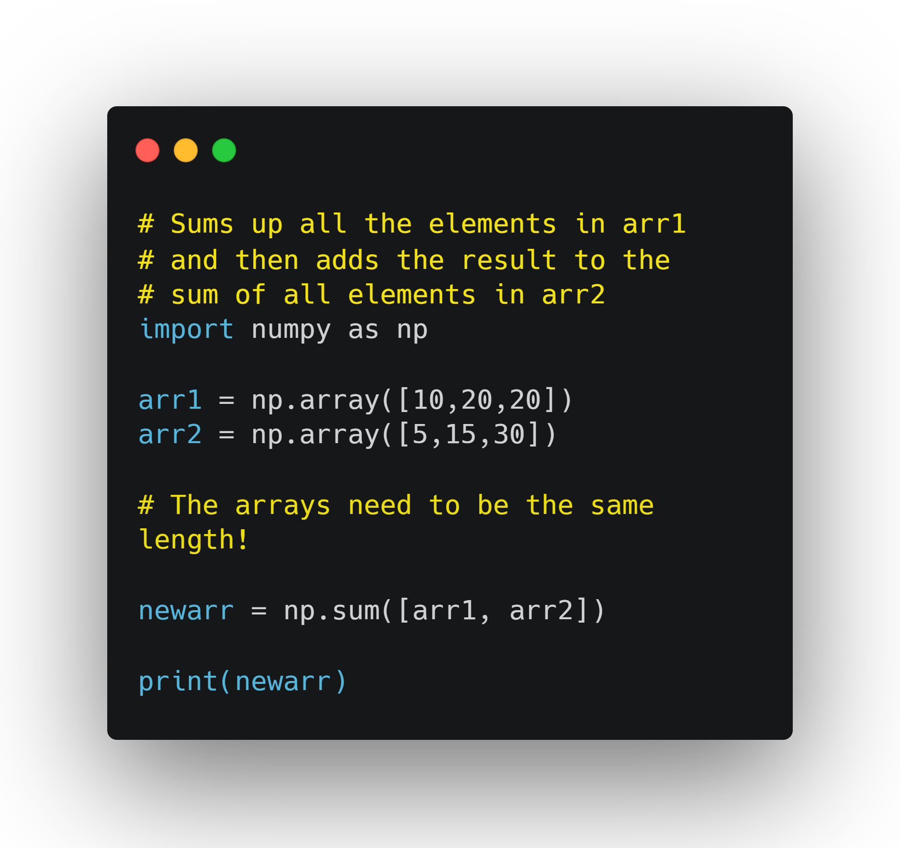
Summations

Slide 46
Axes in Summation
Sum function in NumPy has additional arguments that you can pass to it
Depending on the value of axis, you sum up arrays either row-wise or column-wise (1D arrays only have the row-wise option).

Slide 47
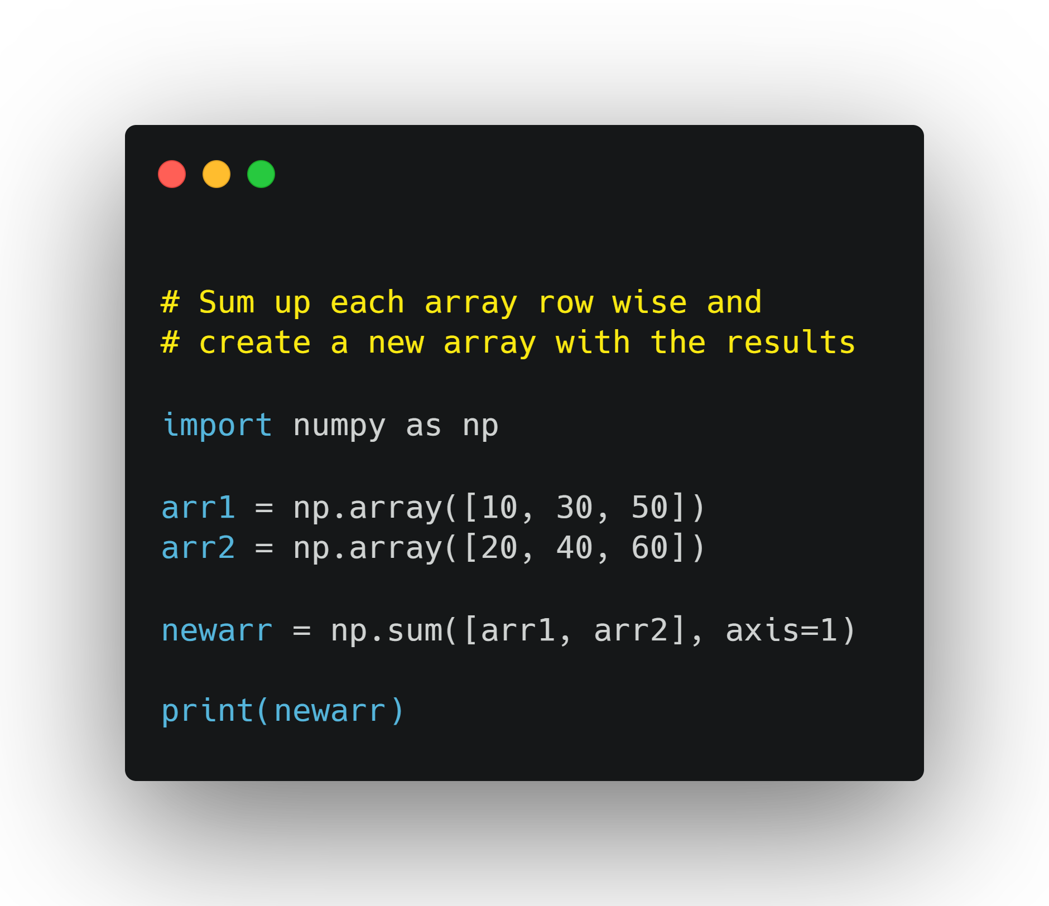

Slide 48
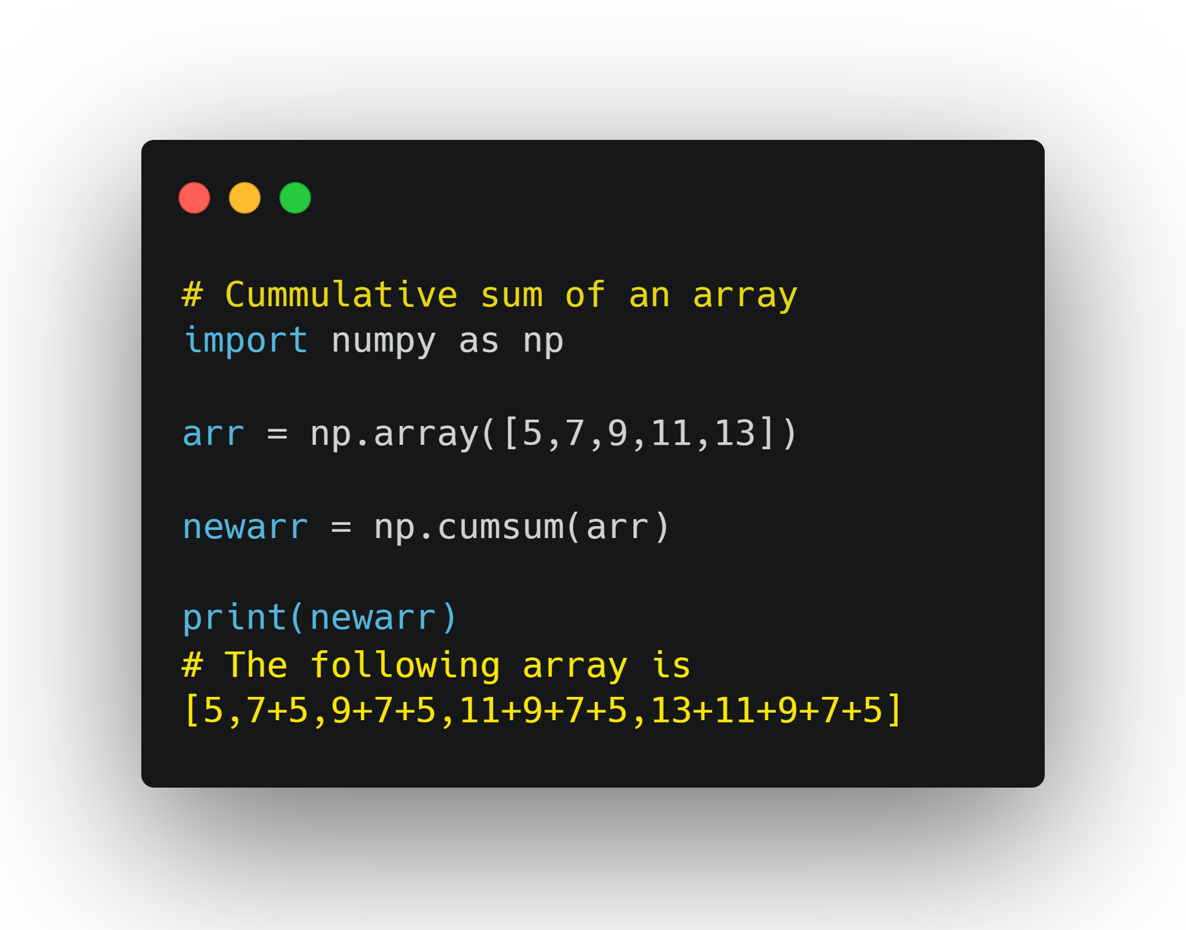
Cumulative Sums
Perform cumulative sums on array
Each element is summed with the previous elements.

Slide 49

Introduction to Statistical Analysis
Learn to perform statistical analysis in NumPy.

Slide 50
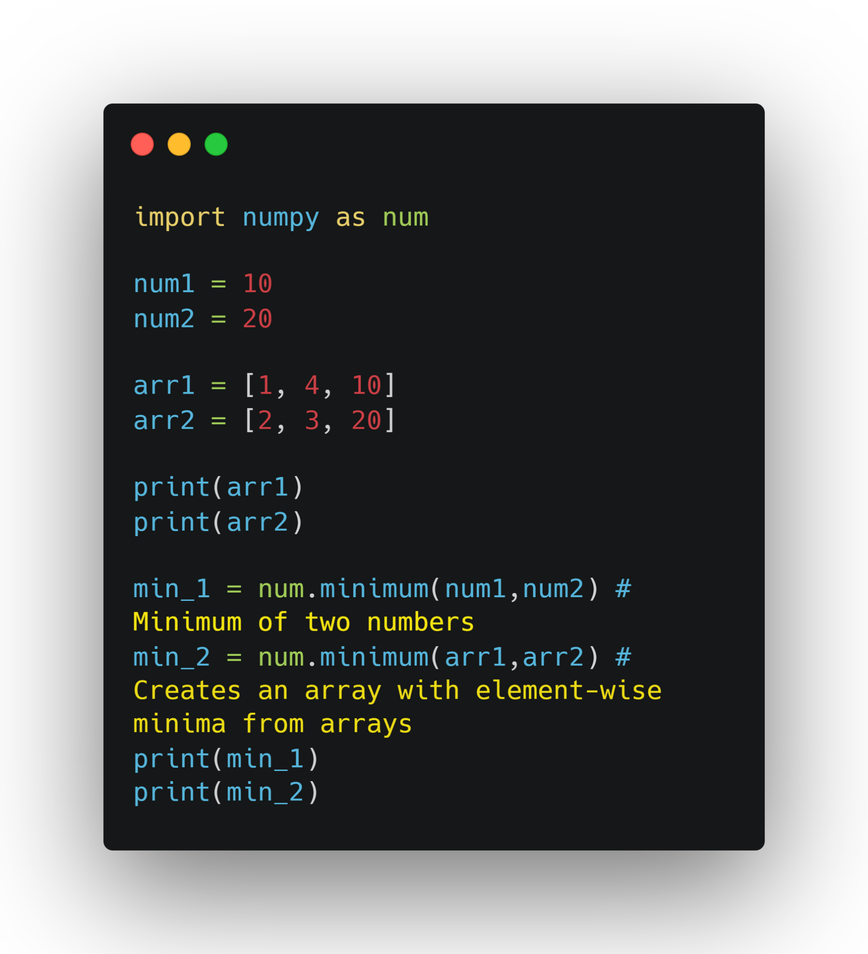
Obtaining Min and Max

Slide 51
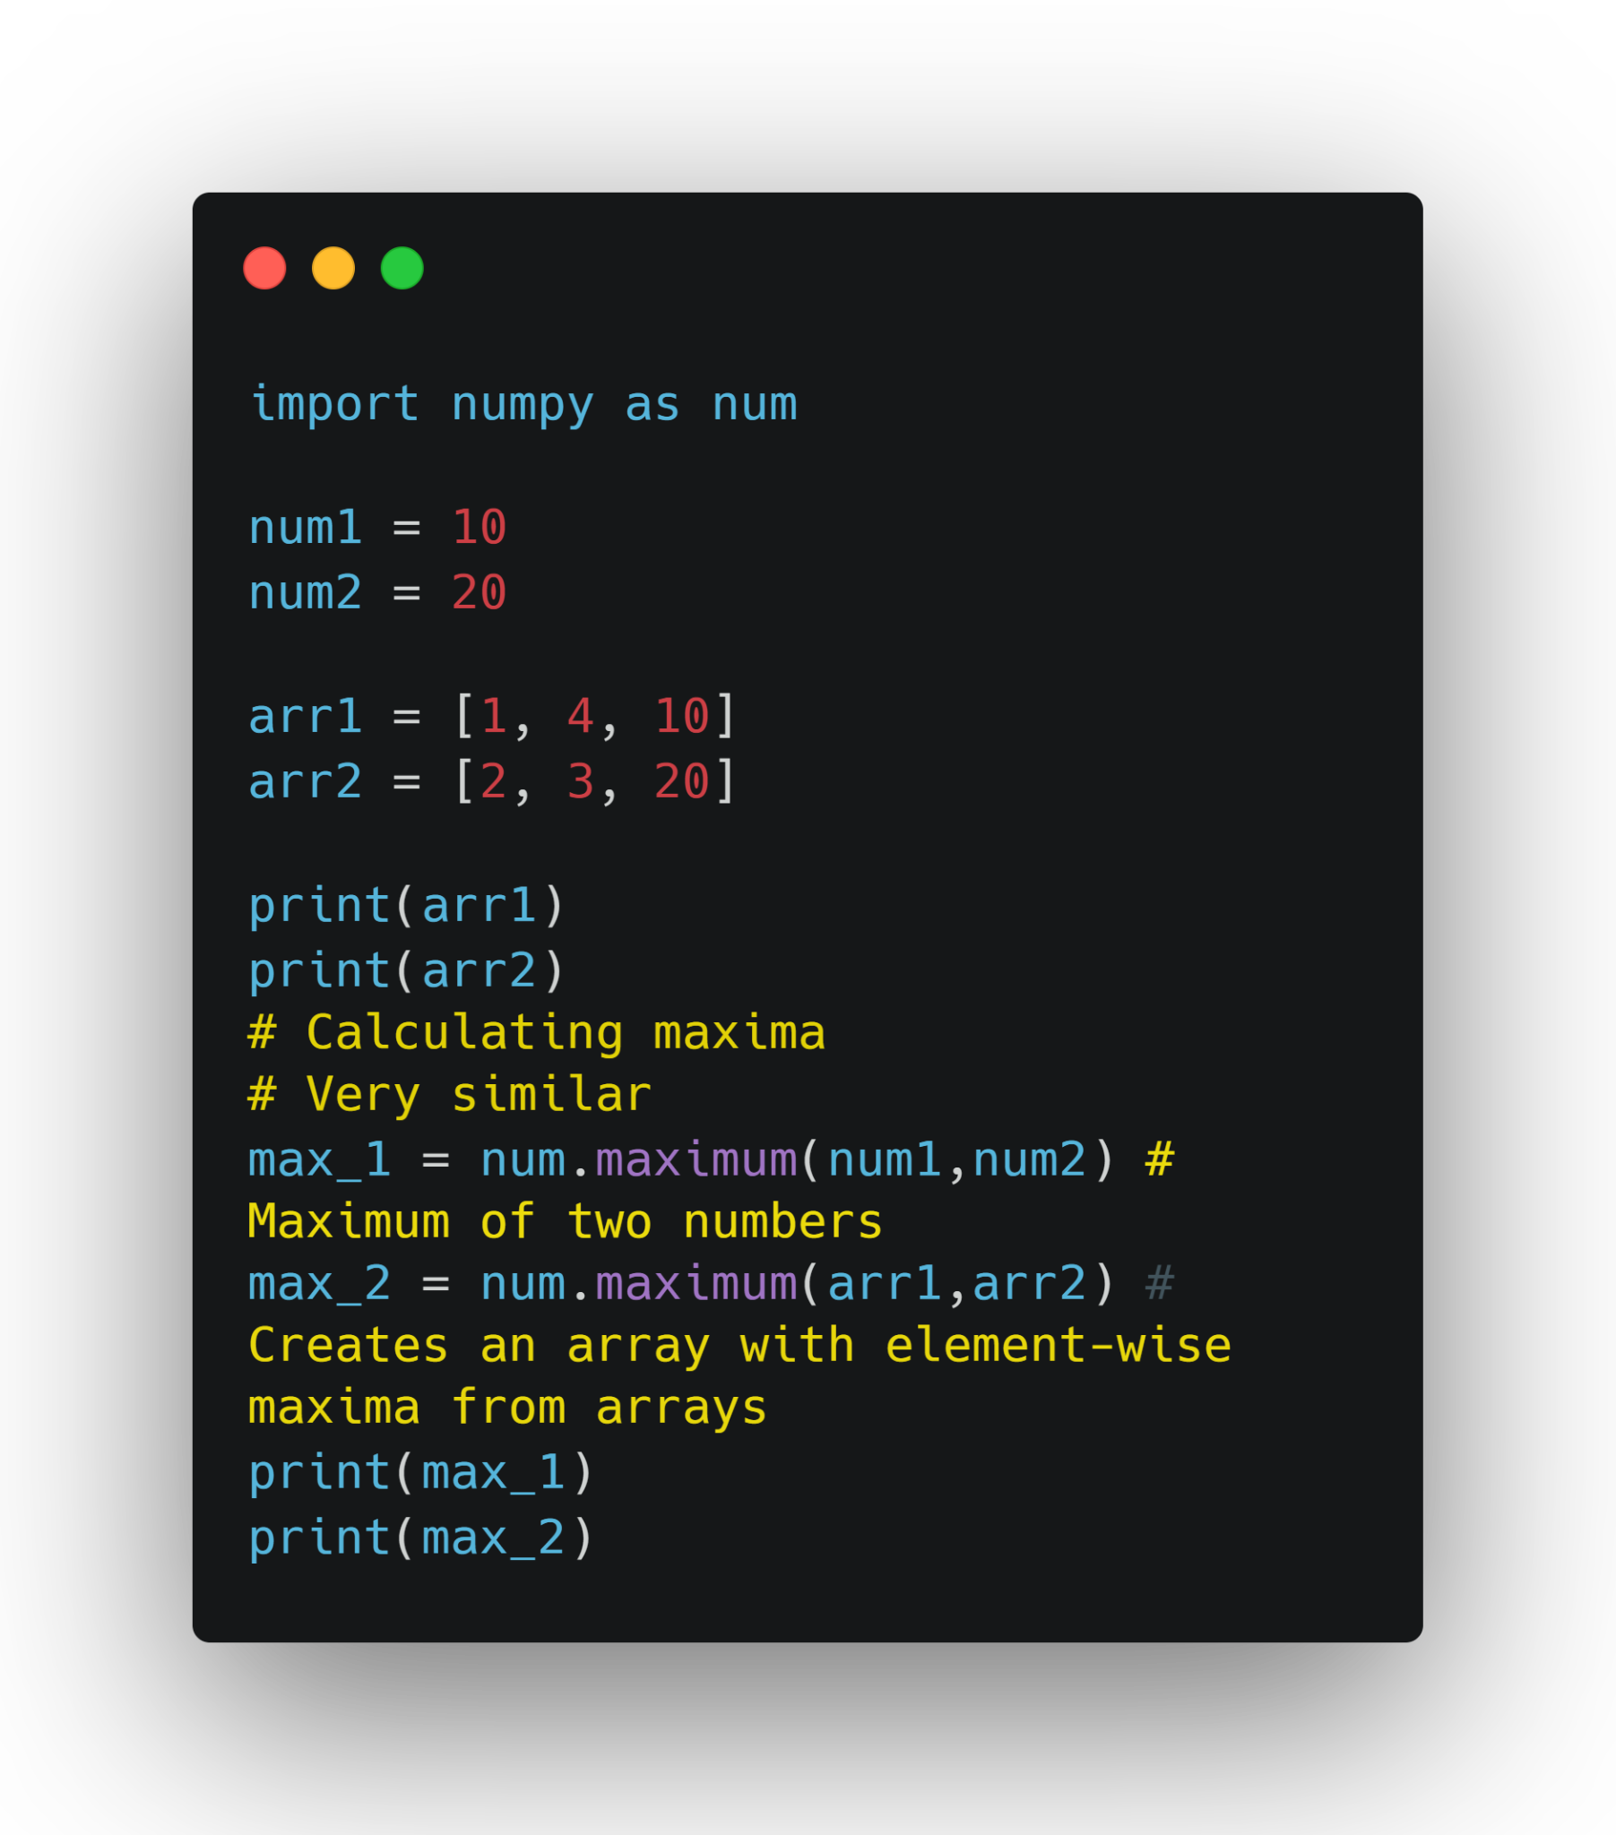

Slide 52
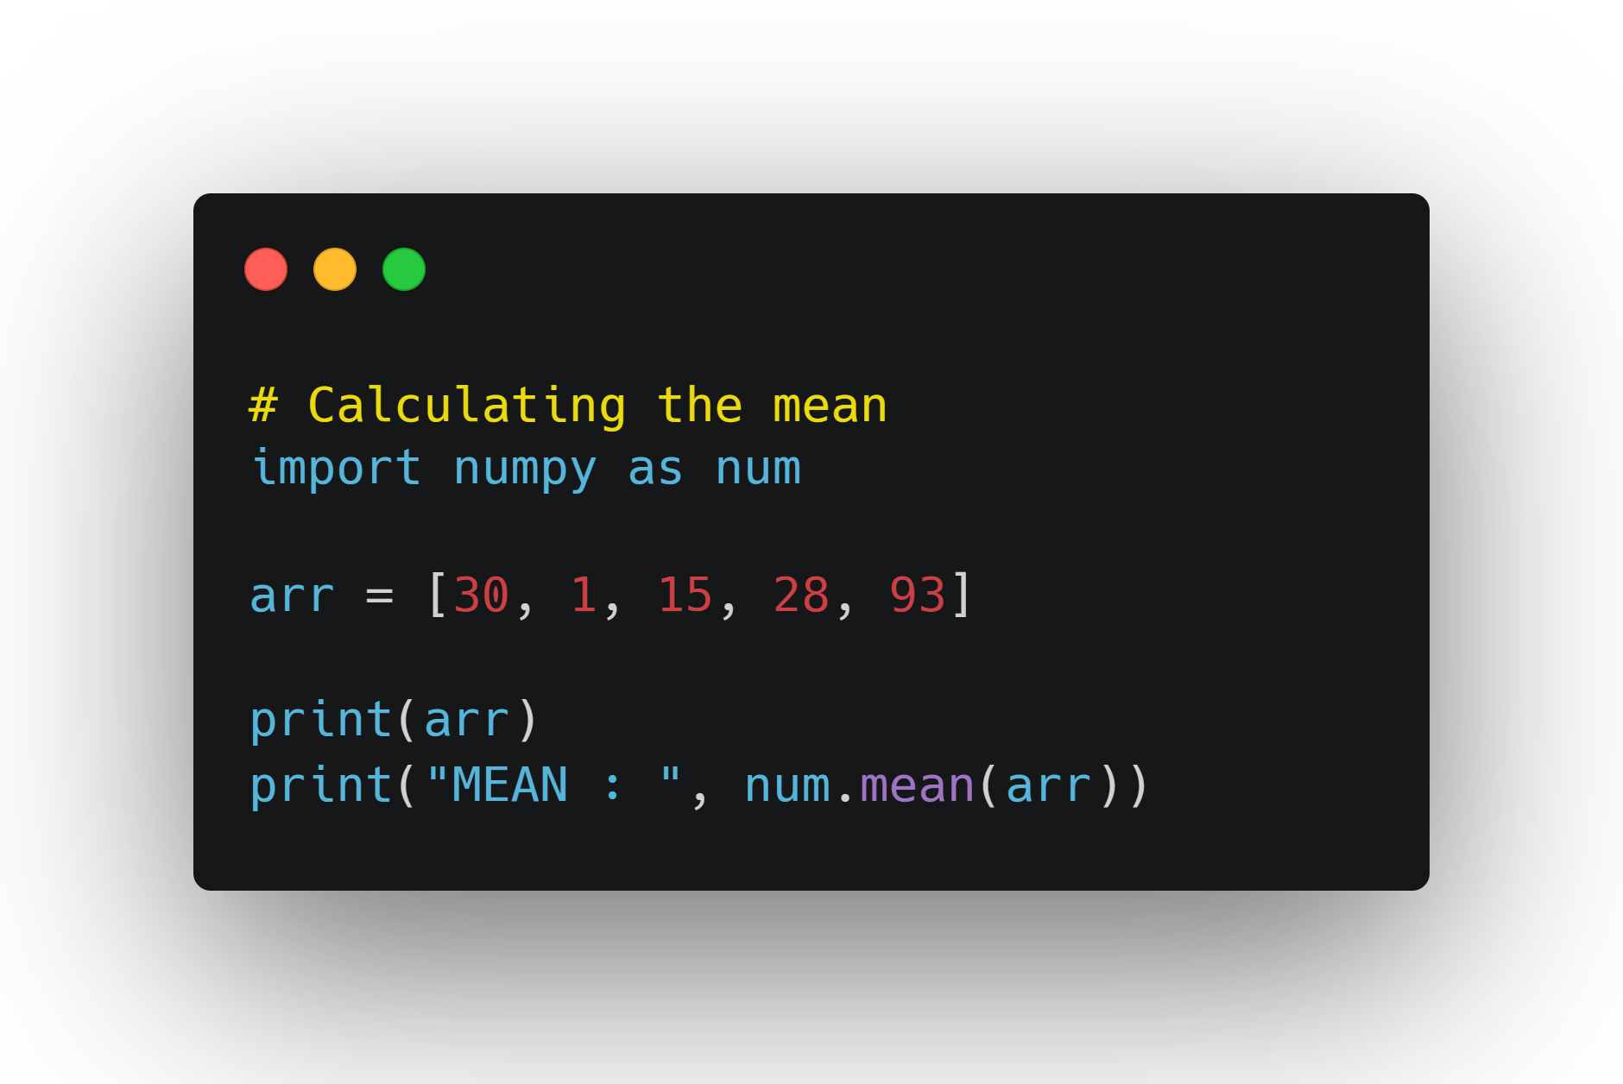
Mean
The average of a set of data.

Slide 53
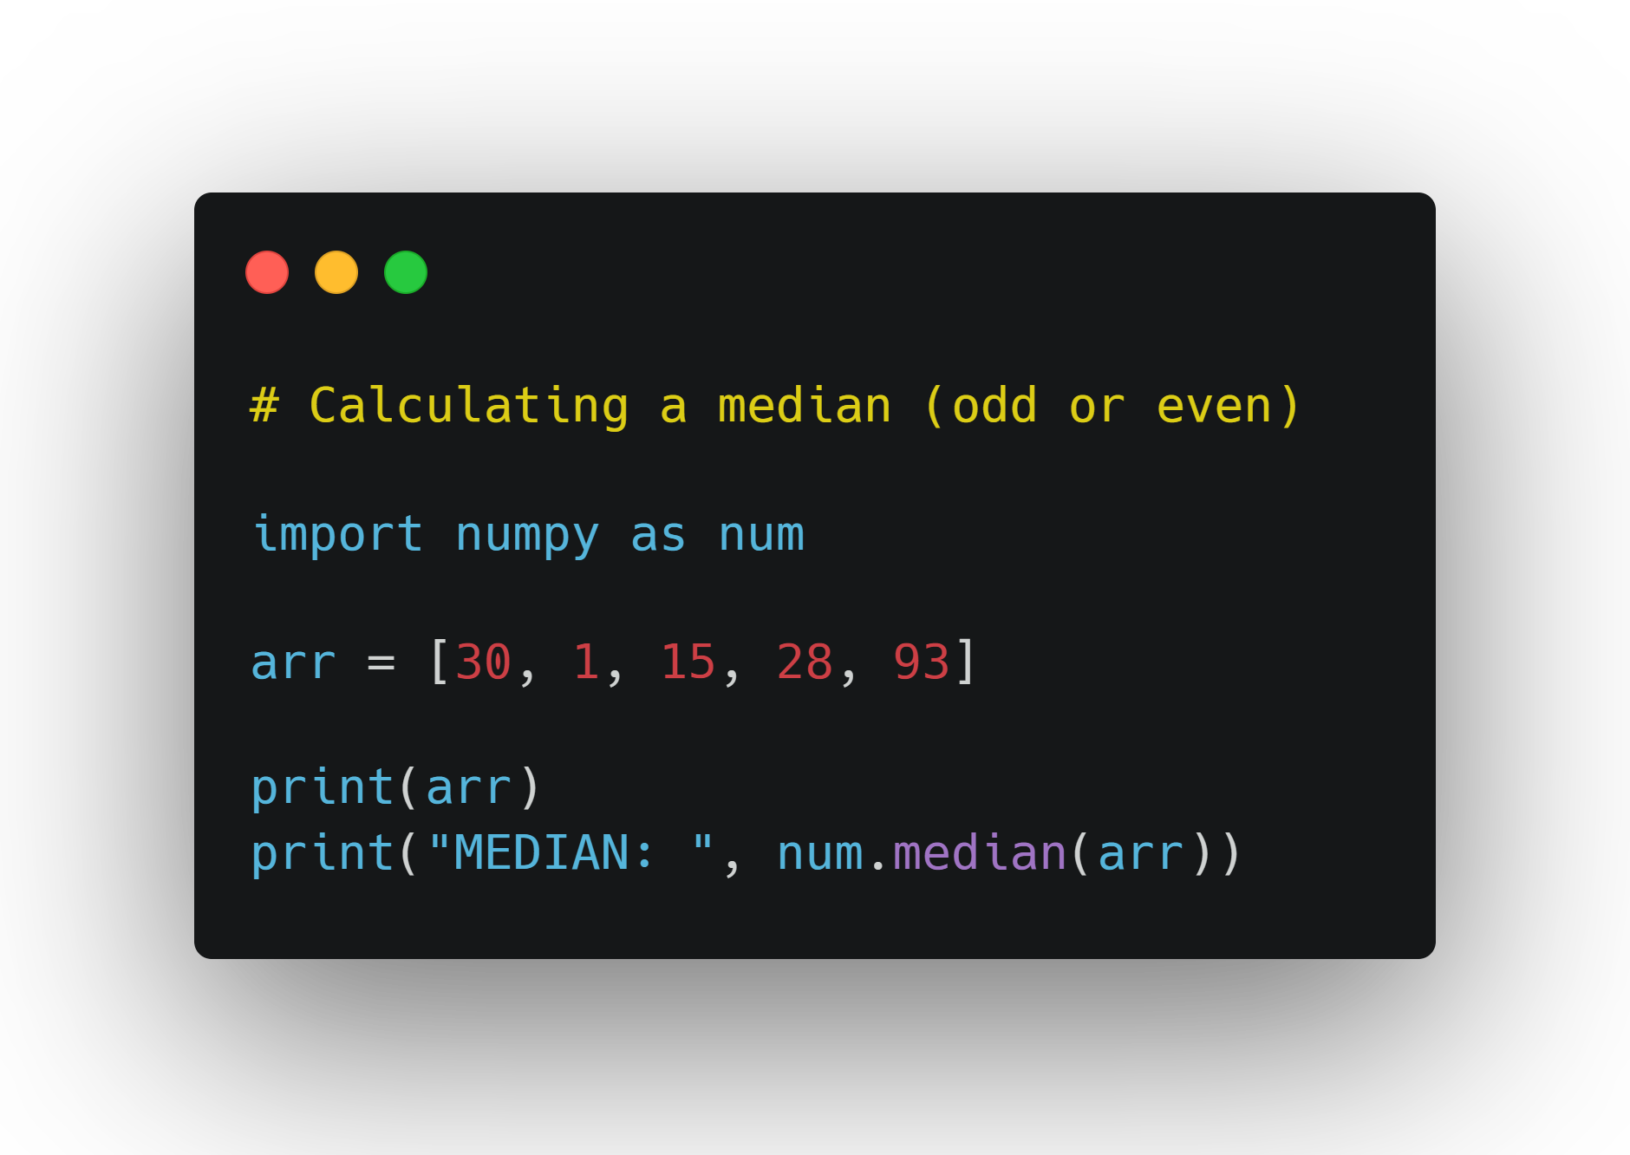
Median
Middle of a set of numbers.
Sometimes this is the same value as the mean, but not always.

Slide 54
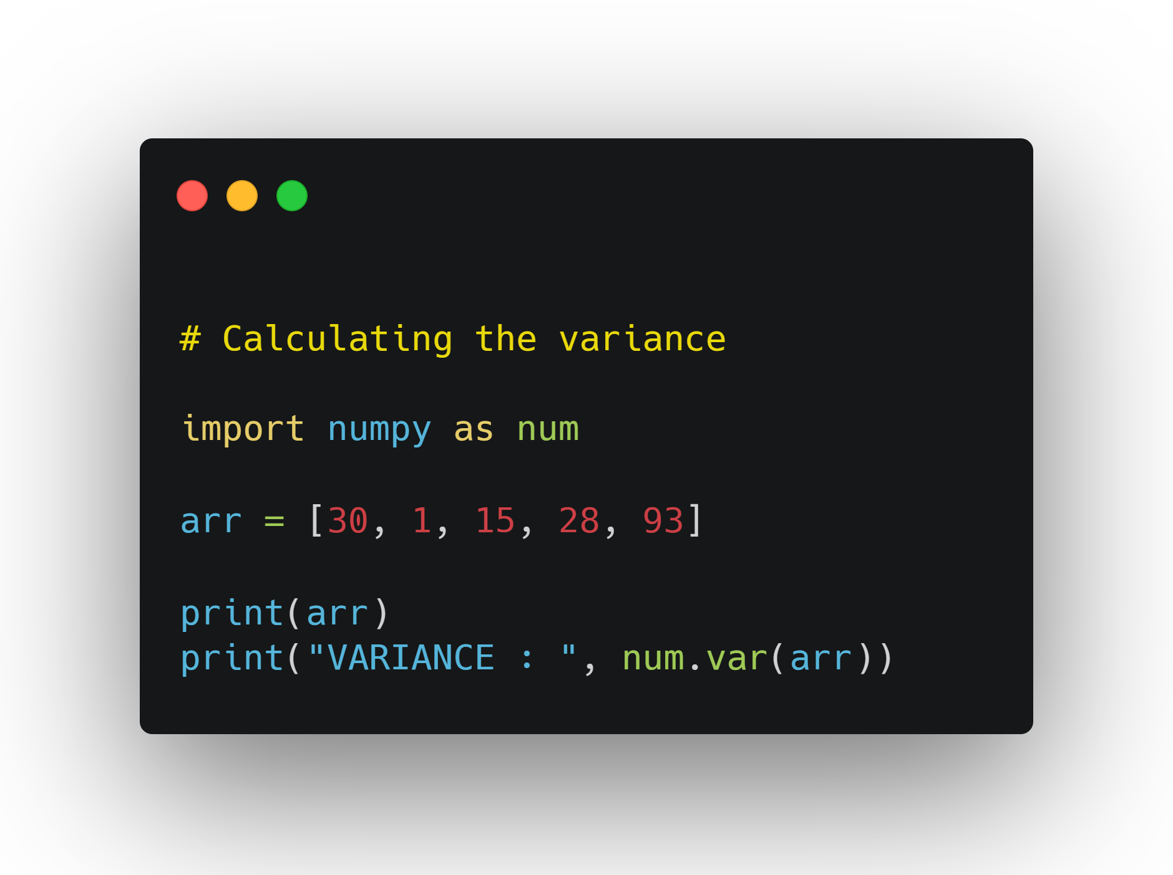
Variance
Informally defined as a measure of how far a set of values are spread out from their average value.

Slide 55
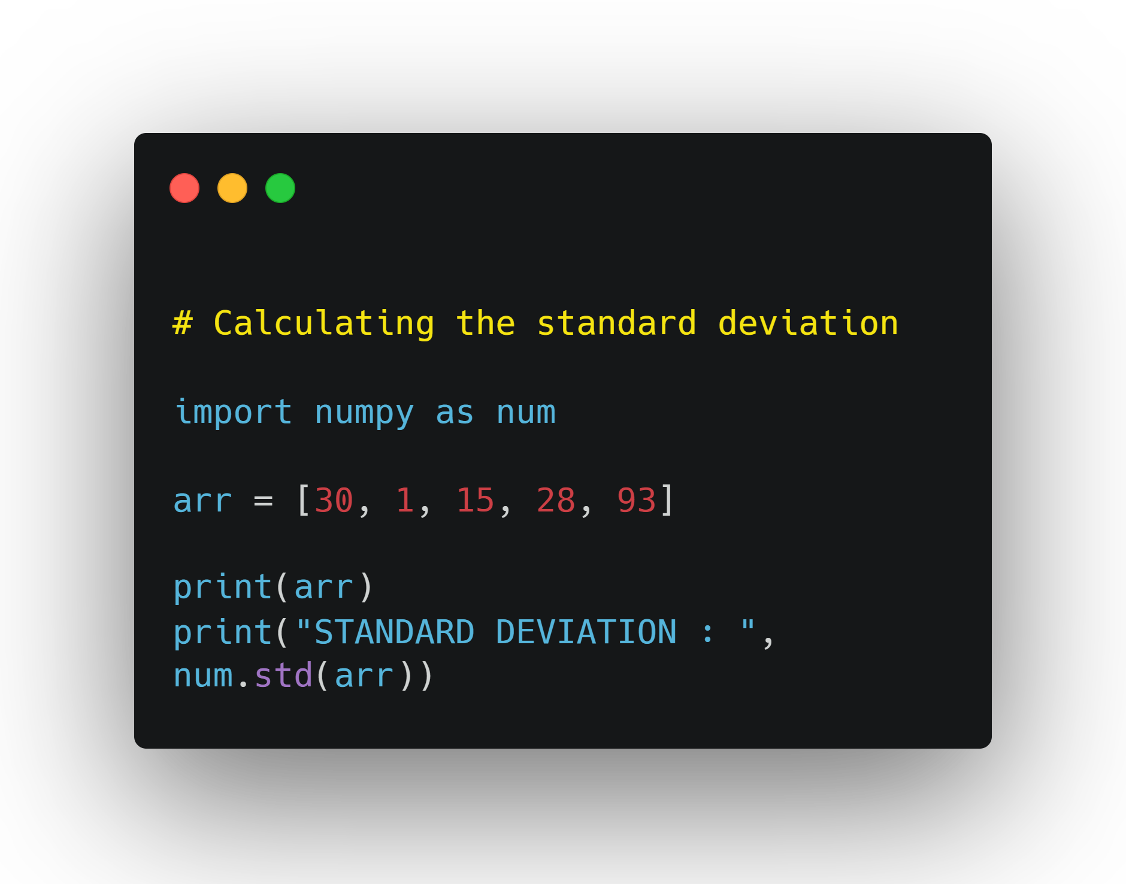
Standard Deviation
Square root of variance.
Helps us tell if a value is an outlier or extreme.
If a value is 3 standard deviation away from the mean, it is an outlier.

Slide 56
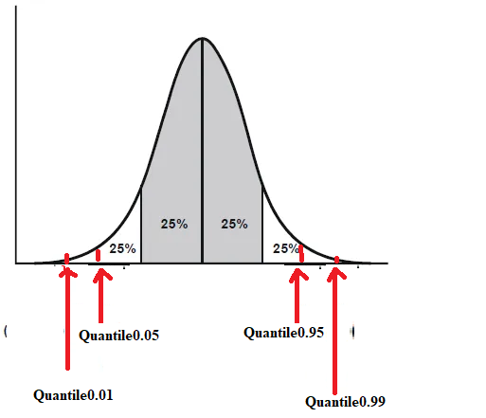
Quantiles
Qth quantile is a number where q% of the values in a distribution fall below that number
Quantiles are generic and can have any value.

Slide 57
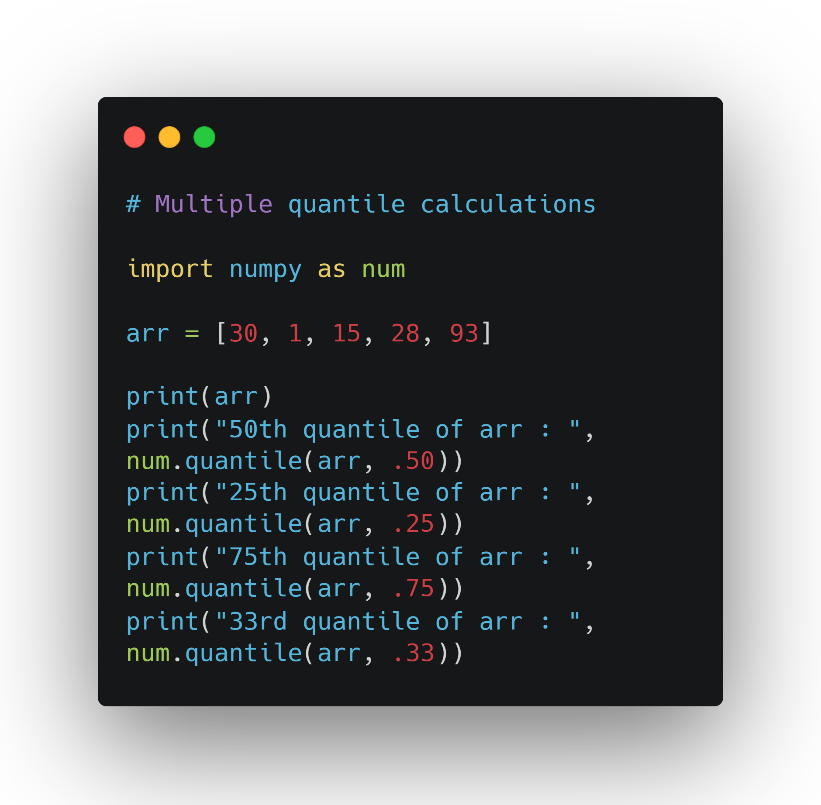

Slide 58
7.0 Now Try This
Create a randomly generated array of any size using either the normal or random distributions. Then, calculate the following statistics for that array:
Mean, Median, Variance, Standard Deviation, 84th quantile.

Slide 59
Covariance
Sometimes you have two or more variables in your data set and would like to know how they vary together as the values change. You can measure that using covariance.
If cov(x,y) = 0 then variables are uncorrelated
If cov(x,y) > 0 then variables are positively correlated
If cov(x,y) < 0 then variables are negatively correlated

Slide 60
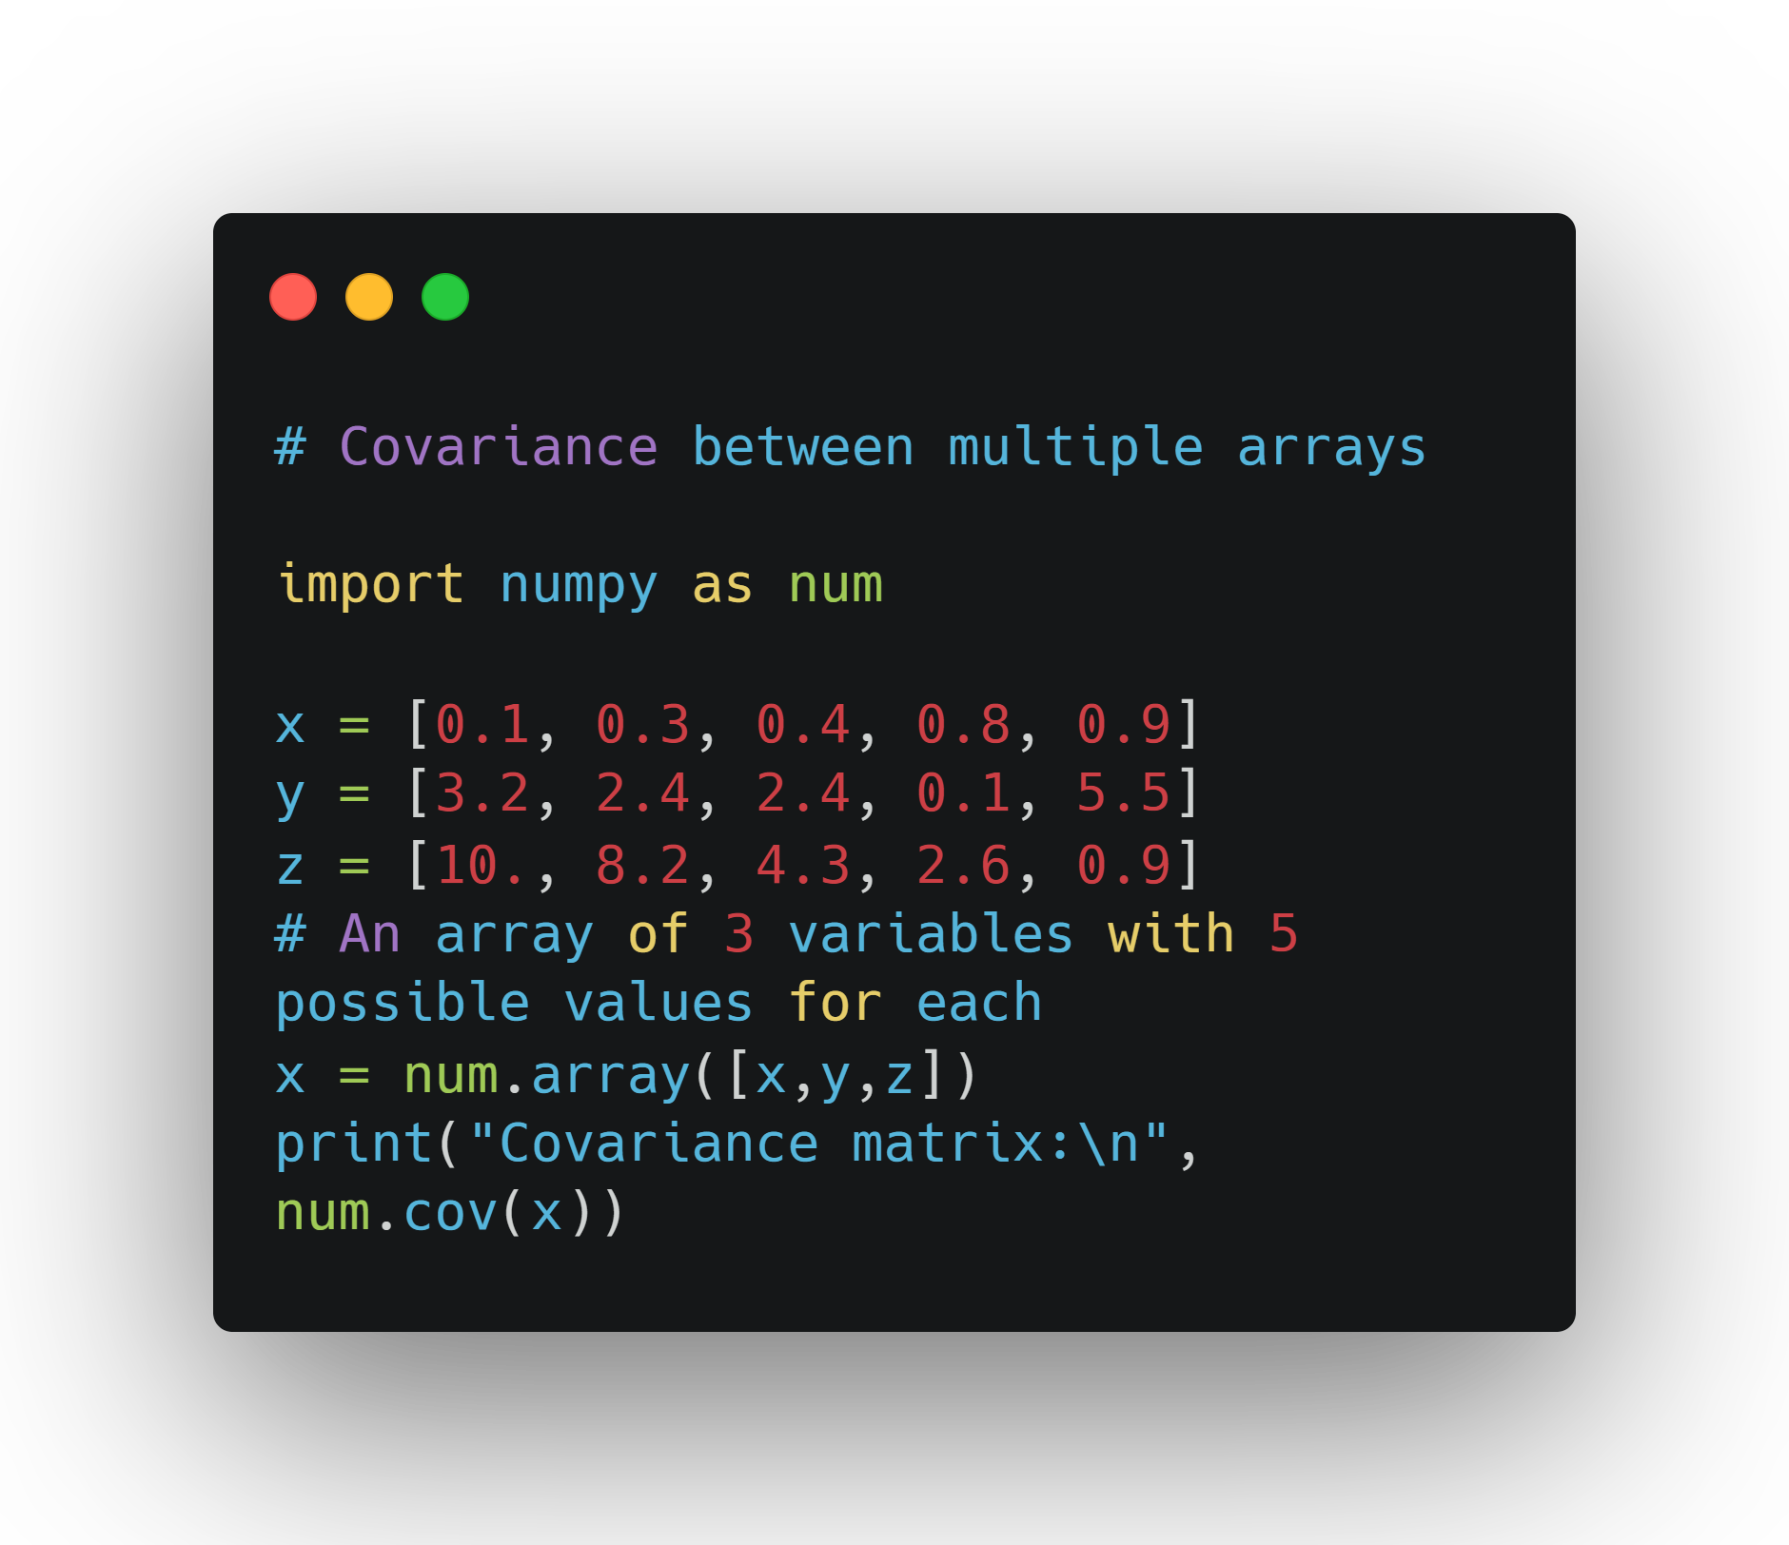

Slide 61
Interpretation of Covariance Matrix
The main diagonal (C_ii) are the variances for each variable. 0.115 is the variance for var_1, 3.757 for var_2, and 14.525 for var_3. The other values in the matrix tell us the direction of correlation between the other variables

Slide 62
Cross - Correlation
Very similar statistic to covariance
Calculate is the cross-correlation between variables
Tells us the strength of the correlation (covariance tells us the direction of the correlation)
Correlation: between -1 and 1 (negative correlation means negative relationship, positive correlation means positive relationship)

Slide 63
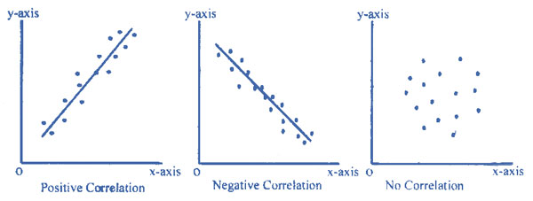
Cross - Correlation (continued)

Slide 64
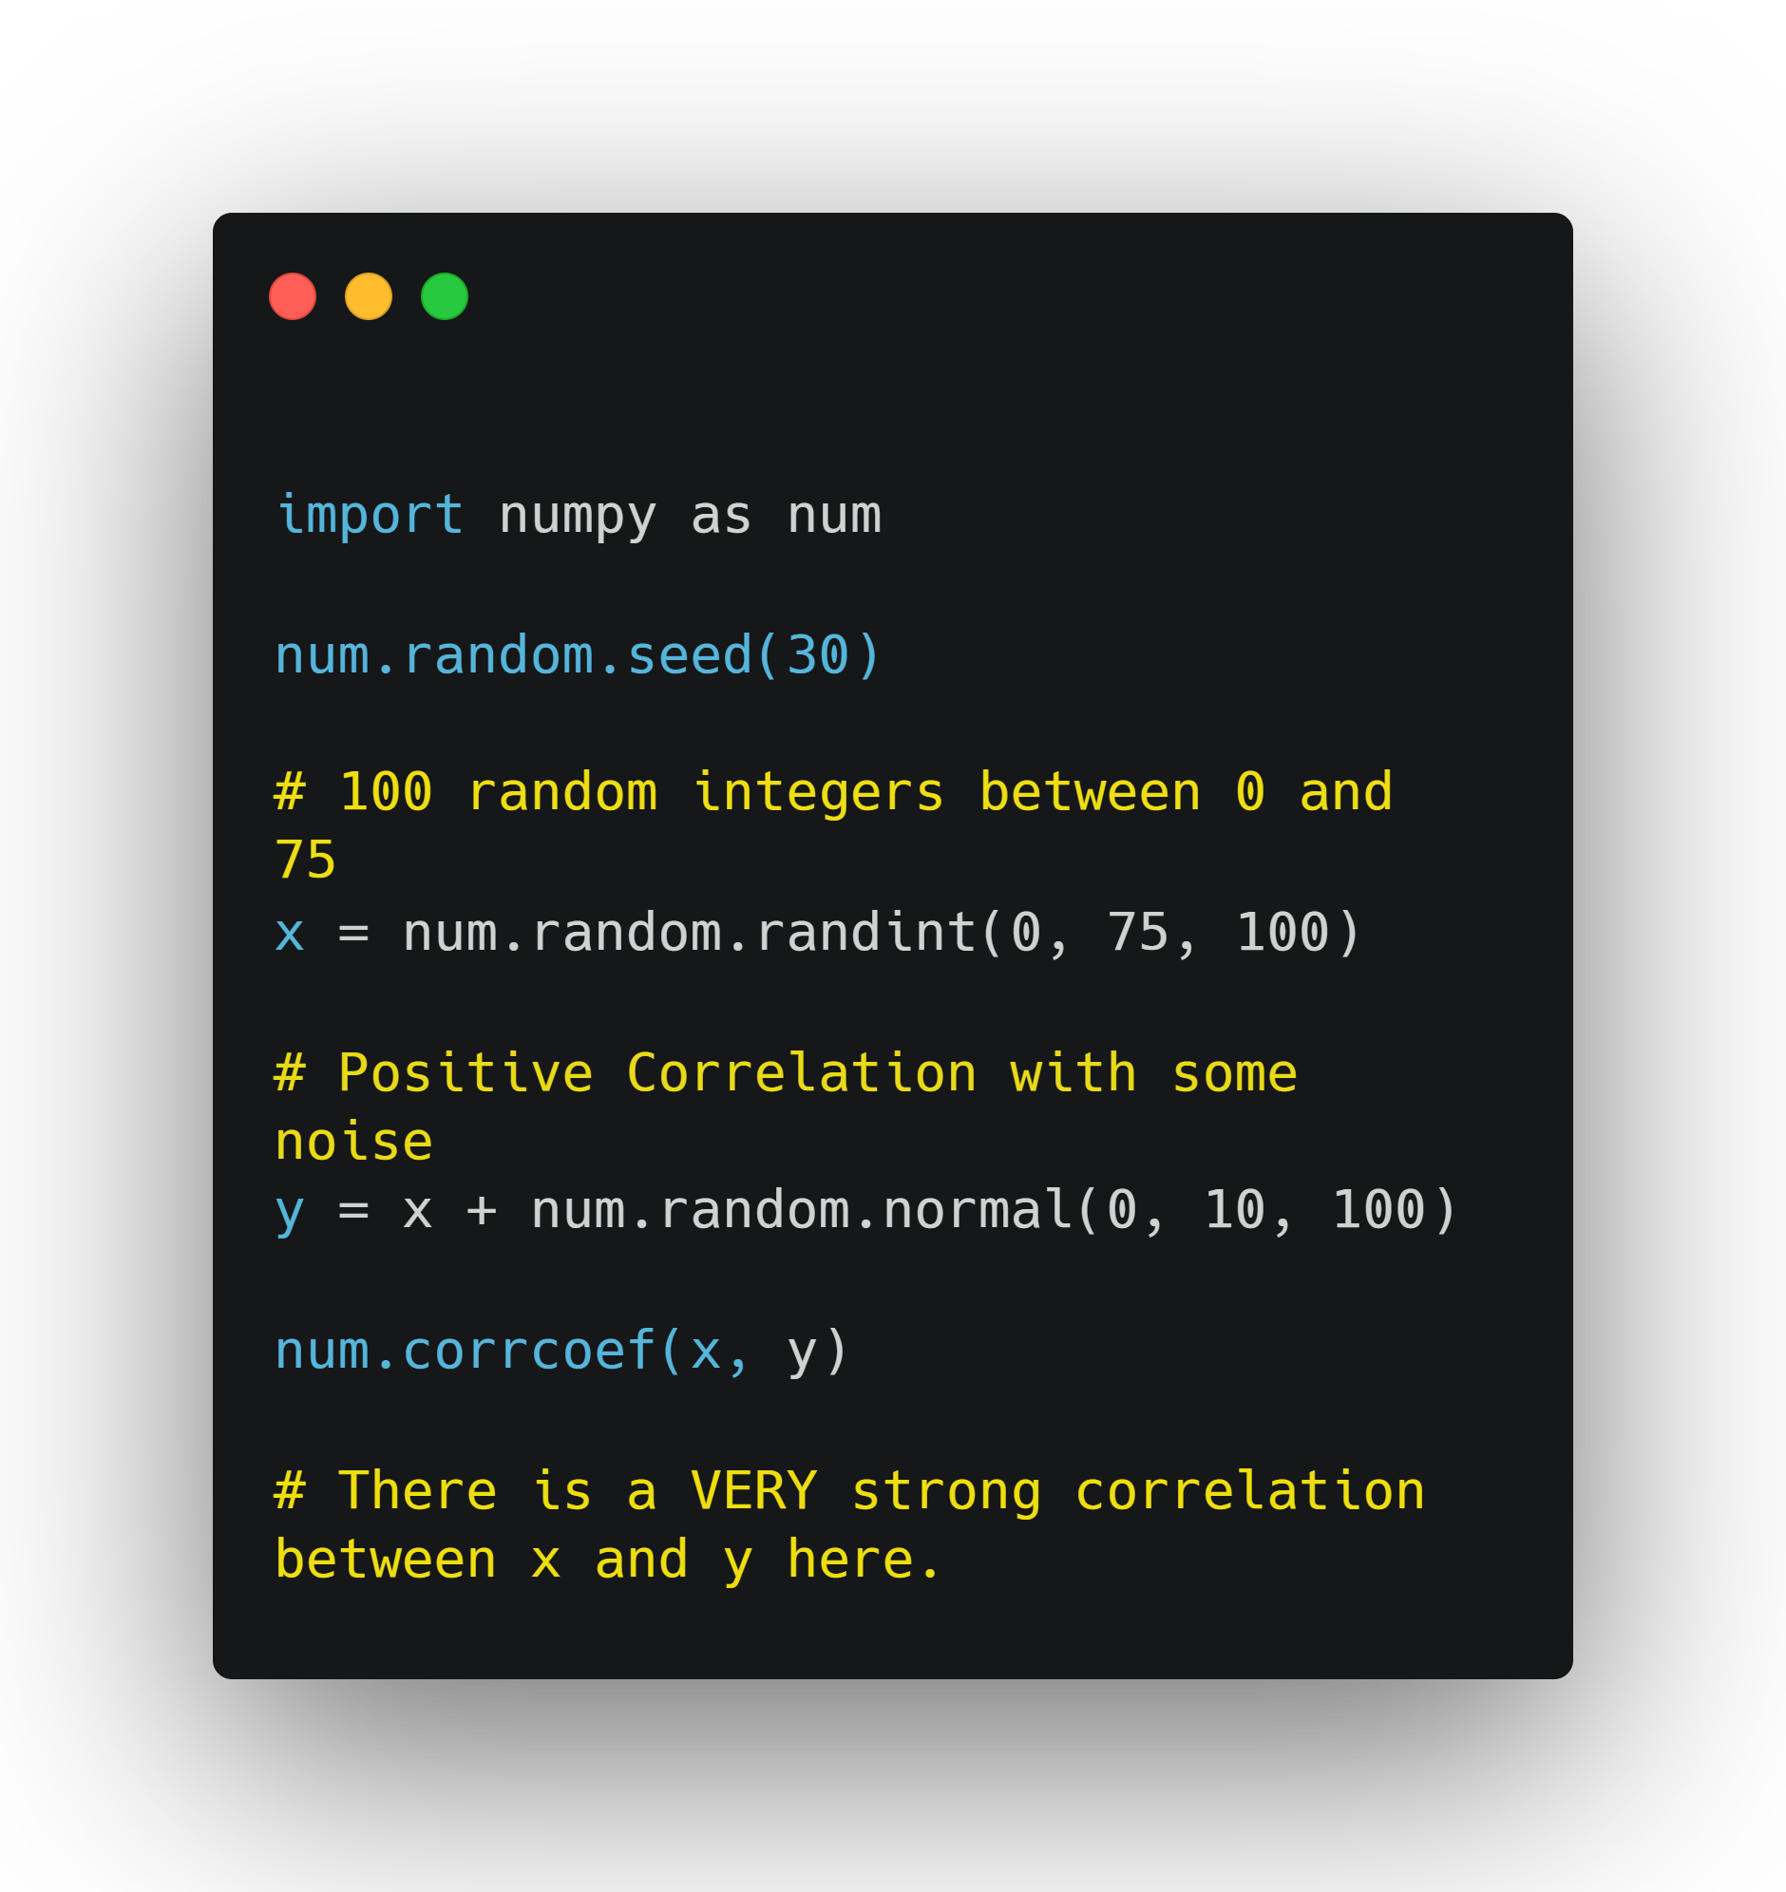

Slide 65
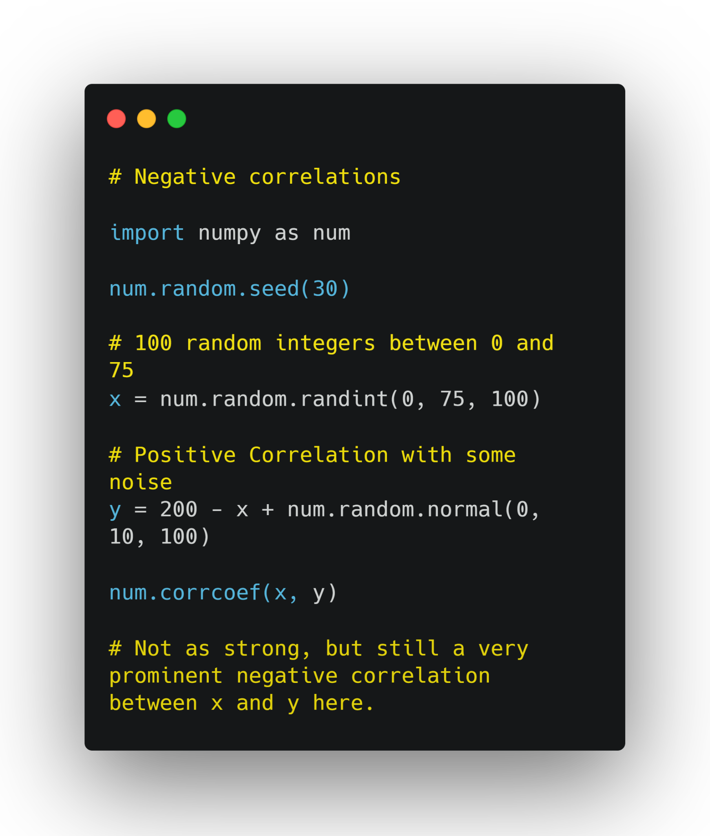

Slide 66
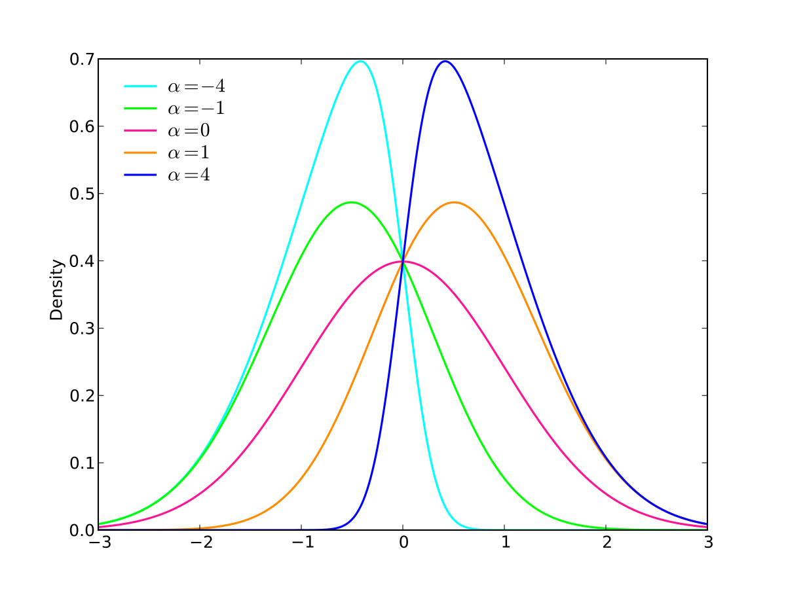
Preview of Exploratory Data Analysis and Linear Regression
Explore the dataset and see if you can find any general insights or broad patterns.
Does the distribution of a certain dataset seem skewed (heavily asymmetric in one direction or the other)?

Slide 67

Exploratory Data Analysis
Pandas_profiling allows us to create a very quick report on datasets that we've imported.
install it in Google Colab, and then import it.

Slide 68


Slide 69


Slide 70
Generate Report
data.profile_report(title='Campus Placement Data - Report', progress_bar=False)
Two key takeaways:
67 Missing values in Salary for students who didn't get placed. These NaN values need to be filled.

Slide 71
Two Key Takeaways (continued)
In salary, 300k at 75th Percentile goes all the way up to 940k max, in Salary (highly skewed). A reminder that a percentile is value where a certain percentage of the total values fall at or below that value. It's very similar to quantiles except that percentiles always range from 0 - 100. In this case, the 75th percentile means that 75% of all salaries are either the same or lower than 300k.

Slide 72
Exploring features of the data
Sometimes columns of a dataset are called features.
One of the basic questions associated with EDA is how features affect each other.
Example:
data.gender.value_counts()
Output:
M 139
F 76
Name: gender, dtype: int64

Slide 73


Slide 74


Slide 75


Slide 76


Slide 77
Takeaways
30 Female and 40 Male students were not recruited. Male students seem to have comparably high recruitment rates.
More outliers for male students. Male students seem to be getting very high salaries after recruitment.
Male students are offered slightly greater salaries than female students on average.

Slide 78

Linear Regression
A very common task in statistical analysis is to try and predict future values of a feature
Or to determine if the value of a feature can be predicted from a combination of values from other features.

Slide 79
Linear Regression (continued)
Linear regression attempts to model the relationship between two variables by fitting a linear equation to observed data.
Explanatory variable (predictor)
Dependent variable
Y = mx + b (modeling y from x. Y is dependent, x is explanatory).

Slide 80


Slide 81


Slide 82
Takeaways
Immediately we can see that a student's employability score is not a good predictor of salary.
Students with vastly different scores can get the same salary
Certain students who got a very low employability score sometimes getting higher salaries than those with high employability scores.

